Slide 1
Microeconomics

Slide 2
Is Economics a Science?

Slide 3
Issues
Economics doesn’t predict well
All its assumptions are wrong
It isn’t even done in good faith

Slide 4
Economics doesn’t predict
Three replies:
No one predicts
Economics actually does (sometimes)
Who needs to predict?

Slide 5
No one predicts
Large, complex systems are hard to predict
Chaos theory – even something as simple as
$x_{t+1}=f\left(x_{t}\right)$
with
$f\left(x\right)=1−4{\left(x−0.5\right)}^{2}$

Slide 6
Chaos
$$f\left(x\right)=1−4{\left(x−0.5\right)}^{2}$$
0 |  | 0.01 | 0.02 | 0.03 | 0.04 | 0.05
1 |  | 0.0396 | 0.0784 | 0.1164 | 0.1536 | 0.19
2 |  | 0.152127 | 0.289014 | 0.411404 | 0.520028 | 0.6156
3 |  | 0.515939 | 0.821939 | 0.968603 | 0.998395 | 0.946547
5 |  | 0.00406 | 0.970813 | 0.427388 | 0.025467 | 0.6457
10 |  | 0.795154 | 0.503924 | 0.524371 | 0.836557 | 0.999652
15 |  | 0.393686 | 0.015682 | 0.494768 | 0.466403 | 0.316366
20 |  | 0.079928 | 0.590364 | 0.027768 | 0.774441 | 0.069137

Slide 7
Chaos
If a single variable with such a simple equation can generate chaos…
Just imagine what happens with the weather (the butterfly effect)
Or the entire global economy
Or the geopolitical system

Slide 8
Two additional complications
In the social sciences:
We don’t even have the basic rules
(no equivalents of flow equations in physics)
We’re dealing with self-reflective systems
(a hurricane doesn’t change its mind if predicted correctly)

Slide 9
Economics actually does predict
Sometimes it doesn’t do too badly
Nice quantitative results on
Supply-and-demand in a single good market
Auctions
Matchings
Many qualitative insights

Slide 10
It is easier to predict when
The system is “small” and isolated
There are many “repetitions” –
similar examples that are causally independent
Experiments are possible
… Maybe we should learn when to expect a theory to predict

Slide 11
Who needs to predict?
Economics would surely like to be a predictive science
But it can be useful even if it isn’t
For instance, even if it can only critique reasoning
Compare with history

Slide 12
All assumptions are wrong
Well, yes
But think of
Robustness of findings?
Relevance to economic decisions?

Slide 13
The Ultimatum Game
There is a sum of $\$100$to share between Players I and II
Player I offers a way to divide the sum (say, integer values)
Player II can say Yes or No
Yes – they get the amounts offered
No – they both get nothing
What will happen?
What does the theory say?

Slide 14
The Ultimatum Game
Bernd Schwarze (b. 1944)
Werner Güth (b. 1944)
Güth, Schmittberger, Schwarze (1982)

Slide 15
Reference
An Experimental Analysis of Ultimatum Bargaining
Werner Güth, Rolf Schmittberger, Bernd Schwarze
Journal of Economic Behavior and Organization, Vol. 3, No. 4 (Dec., 1982), pp. 367-388
Abstract
There are many experimental studies of bargaining behavior, but suprisingly enough nearly no attempt has been made to investigate the so-called ultimatum bargaining behavior experimentally. The special property of ultimatum bargaining games is that on every stage of the bargaining process only one player has to decide and that before the last stage the set of outcomes is already restricted to only two results. To make the ultimatum aspect obvious we concentrated on situations with two players and two stages. In the ‘easy games’ a given amount c has to be distributed among the two players, whereas in the ‘complicated games’ the players have to allocate a bundle of black and white chips with different values for both players. We performed two main experiments for easy games as well as for complicated games. By a special experiment it was investigated how the demands of subjects as player 1 are related to their acceptance decisions as player 2.

Slide 16
What does the theory say?
$$100$$
$$99$$
$$80$$
$$50$$
$$20$$
$$0$$
…
…
…
…
$$yes$$
$$no$$
$$yes$$
$$no$$
$$yes$$
$$no$$
…
…
$$\left(100,0\right)$$
$$\left(0,0\right)$$
$$\left(99,1\right)$$
$$\left(0,0\right)$$
…
$$\left(50,50\right)$$
$$\left(0,0\right)$$
…

Slide 17
Well,
We are tempted to predict:
The “Backward Induction” solution
$$100$$
$$99$$
$$80$$
$$50$$
$$20$$
$$0$$
…
…
…
…
$$yes$$
$$no$$
$$yes$$
$$no$$
$$yes$$
$$no$$
…
…
$$\left(100,0\right)$$
$$\left(0,0\right)$$
$$\left(99,1\right)$$
$$\left(0,0\right)$$
…
$$\left(50,50\right)$$
$$\left(0,0\right)$$
…

Slide 18
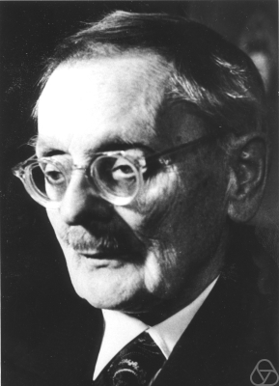
Backward Induction
In a finite game of perfect information we can go down to the leaves and work our way backwards to find the players’ choices
Ernest Zermelo (1871-1953)

Slide 19
Backward Induction assumptions
Rationality
Common knowledge (or common belief) in rationality
To be precise, as many levels of belief as there are steps in the game

Slide 20
So in this case
The backward induction seems to be
– But this assumes that the monetary sums are the “utilities”
$$100$$
$$99$$
$$80$$
$$50$$
$$20$$
$$0$$
…
…
…
…
$$yes$$
$$no$$
$$yes$$
$$no$$
$$yes$$
$$no$$
…
…
$$\left(100,0\right)$$
$$\left(0,0\right)$$
$$\left(99,1\right)$$
$$\left(0,0\right)$$
…
$$\left(50,50\right)$$
$$\left(0,0\right)$$
…

Slide 21
Important
In a game as simple as the Ultimatum Game, it is impossible to test basic decision/game theoretic assumptions (such as transitivity)
We can only test them coupled with the assumption that only material payoffs matter

Slide 22
Emotional payoffs
Player II might be angry/insulted at a low offer
Player II as well as Player I might care for fairness
Player I might be altruistic
etc.
A way to tell some explanations apart: the Dictator Game

Slide 23
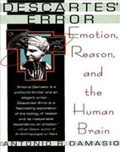
Is it rational to respond to emotions?
In “Descartes’ Error” (1994) argued that it is wrong to think of emotions and rationality as divorced; rather, rationality relies on emotions
Antonio Damasio (b. 1944)

Slide 24
Back to the Ultimatum Game
Having said all that, emotional payoffs should not be overstated
In the Ultimatum Game, if the payoffs were in millions of dollars rather than dollars, acceptance of low offers would likely to be higher
As well as when Player II has to wait before responding

Slide 25
The Ultimatum Game with delay
Let Me Sleep on It: Delay Reduces Rejection Rates in Ultimatum Games
Veronika Grimm, Friederike Mengel
Economics Letters, Vol. 111, No. 2 (2011) pp. 113-115
Abstract
Delaying acceptance decisions in the Ultimatum Game drastically increases acceptance of low offers. While in treatments without delay less than 20% of low offers are accepted, 60-80% are accepted as we delay the acceptance decision by around 10. min.

Slide 26
Not even in good faith
Can science be objective?
Aren’t we always affected by personal history, social class, our incentives?
If so, can we trust the “truths” that economists pretend to have “established”?
Should we check how many economists who believe in the free market also benefit from it (serve on boards of directors etc.) ???

Slide 27
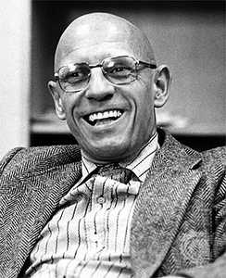
Can science be objective?
Path-breaking studies on the history of madness, sexuality
Michel Foucault (1926-1984)

Slide 28
Shouldn’t we be suspicious?
Well, yes
But – we can try to be (more) objective
Objectivity is a direction, not a place
Let’s remind ourselves of the distinction between Positive and Normative social science
And then ask the question about Postmodernism

Slide 29
Positive vs. Normative
Positive (~ descriptive) IS
Normative (~ prescriptive) OUGHT
Normative physics is called SciFi
But in the social sciences it makes sense

Slide 30
How do we judge theories
Positive – How close to reality it is
Normative – ???
The king in “The Little Prince”

Slide 31
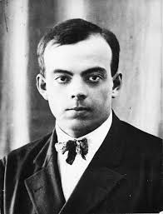
The Little Prince
"It is contrary to etiquette to yawn in the presence of a king," the monarch
said to him. "I forbid you to do so."
"I can't help it. I can't stop myself," replied the little prince, thoroughly
embarrassed. "I have come on a long journey, and I have had no sleep ..."
"Ah, then," the king said. "I order you to yawn. It is years since I have seen
anyone yawning. Yawns, to me, are objects of curiosity. Come, now! Yawn
again! It is an order."
"That frightens me ... I cannot, any more ..." murmured the little prince,
now completely abashed. "Hum! Hum!" replied the king. "Then I—I order
you sometimes to yawn and sometimes to—" He sputtered a little, and seemed
vexed.
For what the king fundamentally insisted upon was that his authority
should be respected. He tolerated no disobedience. He was an absolute
monarch. But, because he was a very good man, he made his orders
reasonable.
"If I ordered a general," he would say, by way of example, "if I ordered a
general to change himself into a sea bird, and if the general did not obey me,
that would not be the fault of the general. It would be my fault."
Antoine de Saint-Exupery (1900-1944)

Slide 32
So what is a good normative theory?
I suggest: one that captures the kind of people/society we want to be
Normative as second-order positive
What type of a decision maker do I want to be?
What kind of a society/economy do I want to live in?

Slide 33
Be that as it may
Let’s not mix up positive and normative
There may never be eternal peace (positive)
But this doesn’t mean we should start shooting each other (normative)
Our theories may never be perfectly objective (positive)
But this doesn’t mean we shouldn’t try (normative)

Slide 34
Utility Maximization

Slide 35
Who maximizes utility ?
Or rather, who behaves as if they did?
Logical positivism and the emphasis on observables
The revealed preferences paradigm

Slide 36
What’s observable ?
Choices: between pairs or out of sets?
Deterministic or stochastic?
If sets – all sets? Only budget sets?
These are all questions of modeling…

Slide 37
Binary relations
$X −$ a set of alternatives
$R ⊂ X×X$ – a binary relation
$R$ is reflexive if $xRx$ for all $x$
symmetric if $yRx$ whenever $xRy$
transitive if $xRz$ whenever [$xRy and yRz$]
complete if $xRy or yRx$ (or both) for all $x,y$

Slide 38
Equivalence relations
$R$ is a equivalence relation if it is reflexive, symmetric and transitive
For example: equality $=$
is reflexive if $x=x$ for all $x$
symmetric if $y=x$ whenever $x=y$
transitive if $x=z$ whenever [$x=y and y=z$]

Slide 39
Equivalence relations – examples
$R$ is a equivalence relation if it is reflexive, symmetric and transitive
For example:
$xRy$ iff $x$and$y$ have the same (first) last name
$xRy$ iff $x$and$y$ have the same height
$xRy$ iff $x$and$y$ have the remainder after division by 3

Slide 40
Equivalence relations – examples
More generally, define$xRy$ iff $f\left(x\right)=f\left(y\right)$ for some function $f:X→Z$
Then $R$is
reflexive if $f\left(x\right)=f\left(x\right)$ for all $x$
symmetric if $f\left(y\right)=f\left(x\right)$ whenever $f\left(x\right)=f\left(y\right)$
transitive if $f\left(x\right)=f\left(z\right)$ whenever [$f\left(x\right)=f\left(y\right) and f\left(y\right)=f\left(z\right)$]
Are there others?

Slide 41
Equivalence classes
An equivalence relation $R$ divides the set $X$ into equivalence classes:
There is a partition of $X$, $\left\{A_{i}\right\}$ (finite or infinite) such that
$xRy$ iff both $x,y$ belong to the same $A_{i}$
This also means that $R$ is an equivalence relation iff there is some (set $Z$ and some) function $f:X→Z$ such that
$xRy$ iff $f\left(x\right)=f\left(y\right)$

Slide 42
Preference relations
$≽$ is a preference relation if it is complete and transitive
A fact: a complete relation is reflexive

Slide 43
Preference relations – weak and strict
For a relation $≽$define $≻$ and $\sim$ by
$$x≻y if x≽y but not y≽x$$
$$x \sim y if x≽y and y≽x$$
(Define also $≼$ and $≺$ )
Facts:
If $≽$is transitive, then so is $\sim$
If$≽$ is transitive, then so is $≻$

Slide 44
If $≽$is transitive, then so is $\sim$
Recall that $x \sim y if x≽y and y≽x$
If we have
$x \sim y$ and $y \sim z$
then
$x≽y and y≽x$ $y≽z and z≽y$
$$x≽z and z≽x$$
So that we have
$$x \sim z$$

Slide 45
If $≽$is transitive, then so is $≻$
Recall that $x≻y if x≽y but not y≽x$
We need to show that
$x≻y$ and $y≻z$
Implies
$$x≻z$$
Or: IF
$x≽y but not y≽x$ and $y≽z but not z≽y$
THEN
$$x≽z but not z≽x$$

Slide 46
$$x≽z$$
We have
$x≻y$ and $y≻z$
that is,
$x≽y but not y≽x$and $y≽z but not z≽y$
then, by transitivity (of $≽$)
$$x≽z$$

Slide 47
$$not z≽x$$
We have
$x≻y$ and $y≻z$
that is,
$x≽y but not y≽x$and $y≽z but not z≽y$
Could it be that $z≽x$ also holds?
No, because then we would have
$z≽y$

Slide 48
Utility representation
For a relation$≽$ on a set $X$ and a function $u:X→\left(−∞,∞\right)$ we say that $u$ represents$≽$ if, for all $x,y$,
$$x≽y iff u(x)≥u(y)$$

Slide 49
Different notions of representation
For a relation $≽$ on a set $X$ and a function $u:X→\left(−∞,∞\right)$
(i) for all $x,y$ $x≽y iff u(x)≥u(y)$
(ii) for all $x,y$ $x≻y iff u\left(x\right)>u(y)$
(iii) for all $x,y$ $x \sim y iff u\left(x\right)=u(y)$
Fact: If $≽$ is complete, (i) and (ii) are equivalent, and each implies (iii)
(but not the other way around)

Slide 50
Equivalence of (i) and (ii)
(i) For all $x,y$ $x≽y⟺u(x)≥u(y)$
(ii) For all $x,y$ $x≻y⟺u\left(x\right)>u(y)$
Given completeness, this is just using the contrapositive:
to say that $p⇒q$
is equivalent to saying that $¬q⇒¬p$

Slide 51
Contrapositives
The (“material”) implication $p⇒q$
is equivalent to $¬q⇒¬p$
In fact, the material implication $p⇒q$ is defined as $¬p⋁q$
And the truth value of $¬p⋁q$ is
– the same as the truth value of $¬q⇒¬p$ which is (again) defined as
$$¬(¬q)⋁(¬p)=¬p⋁q$$
Value of $¬p⋁q$ | $$q$$ | $$¬q$$
$$p$$ | $$∨$$ | –
$$¬p$$ | $$∨$$ | $$∨$$

Slide 52
Back to the equivalence of (i) and (ii)
(i) For all $x,y$ $x≽y⟺u(x)≥u(y)$
(ii) For all $x,y$ $x≻y⟺u\left(x\right)>u(y)$
Given completeness:
$x≽y⇒u(x)≥u(y)$ iff $u\left(y\right)>u(x)⇒y≻x$
$u(x)≥u(y)⇒x≽y$ iff $y≻x⇒u\left(y\right)>u(x)$
Hence (i) is equivalent to
For all $x,y y≻x⟺u\left(y\right)>u(x)$
– which is (ii) with $x,y$ reversed

Slide 53
And (i) [hence (ii)] implies (iii)
(i) For all $x,y$ $x≽y⟺u(x)≥u(y)$
(iii) For all $x,y$ $x \sim y ⟺u\left(x\right)=u(y)$
Because
$x \sim y$ $⟺$ $⟺u\left(x\right)=u(y)$
$$x \sim y$$
$$x≽y$$
$$y≽x$$
$$u(x)≥u(y)$$
$$u(y)≥u(x)$$
$$⟺$$
$$⟺$$

Slide 54
Why doesn’t (iii) imply (i) ?
(i) For all $x,y$ $x≽y⟺u(x)≥u(y)$
(iii) For all $x,y$ $x \sim y ⟺u\left(x\right)=u(y)$
Because representing indifference doesn’t guarantee that preference is also “faithfully” represented
For a given $≽$ and $u$ that represents it, consider $v\left(x\right)=−u(x)$

Slide 55
Conditions for utility representation
For a relation$≽$ on a finite set $X$,
$≽$ is complete and transitive
IFF
There exists a function $u:X→\left(−∞,∞\right)$ that represents $≽$

Slide 56
Interpretation I: meta-scientific
For a relation$≽$ on a finite set $X$
$≽$ is complete and transitive
IFF
There exists $u:X→\left(−∞,∞\right)$ that represents $≽$
What is “utility” ?
The term derives its meaning from its usage (Ask not, “What?”, Ask, “How?”)
We’ll explain what it means to maximize utility in terms of observables

Slide 57
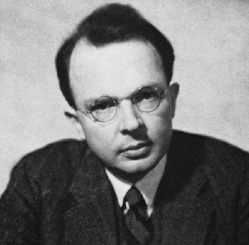
Logical Positivism
What is [good] “science”?
Theoretical terms should be defined by observations
Culminated in the “Received View” (Carnap, 1923)
Rudolf Carnap (1891-1970)

Slide 58
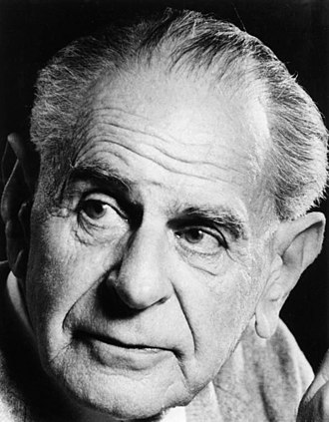
Logical Positivism +
Popper (1934)
A theory is meaningful only if it is refutable
It can never be verified, only refuted, or not-yet-refuted
Famous targets of critic: Marx’s historicism, Freud’s psychoanalysis
(Evolution? Game theory?)
Karl Popper (1902-1994)

Slide 59
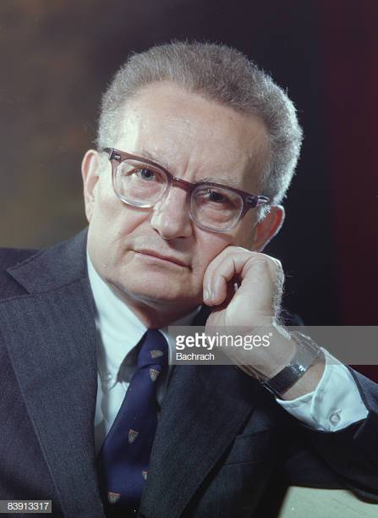
Logical Positivism and economics
Popper (1934) criticizes psychology
Samuelson (1938) pioneers “revealed preference theory”
Room for speculation…
Paul Samuelson (1915-2009)

Slide 60
Economics and psychology
Loewenstein (1988) suggested that, maybe, in the 1930s, economics didn’t think that psychology was such great company
George Loewenstein (b. 1955)

Slide 61
Was it really Logical Positivism?
Moscati is a serious historian who argues that I’m selling you fake history
But the story is too good to kill
Ivan Moscati (b. 1955)

Slide 62
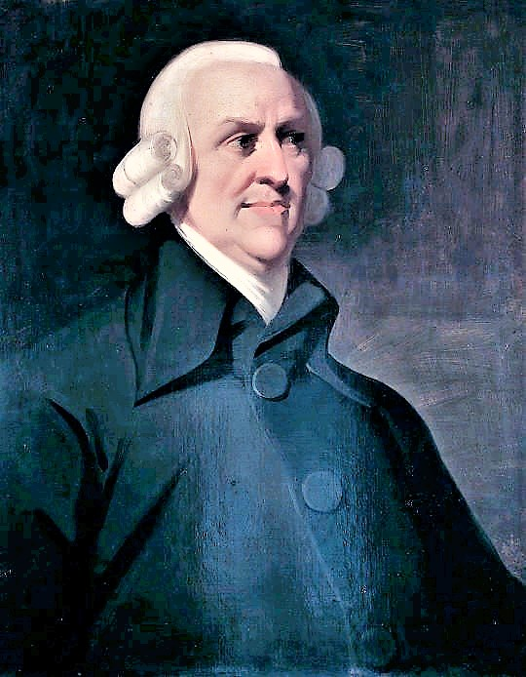
Utility and marginal utility
Adam Smith (as Plato) thought that there is no relationship between value and price
Cf. water and diamonds
Adam Smith (1723-1790)

Slide 63
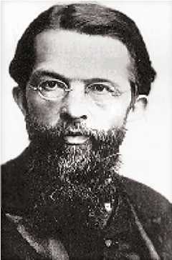
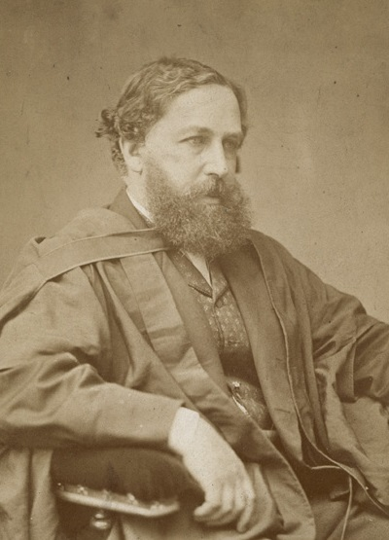
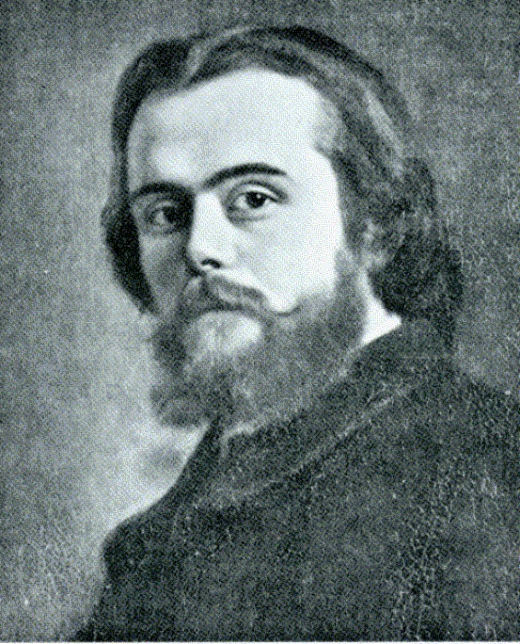
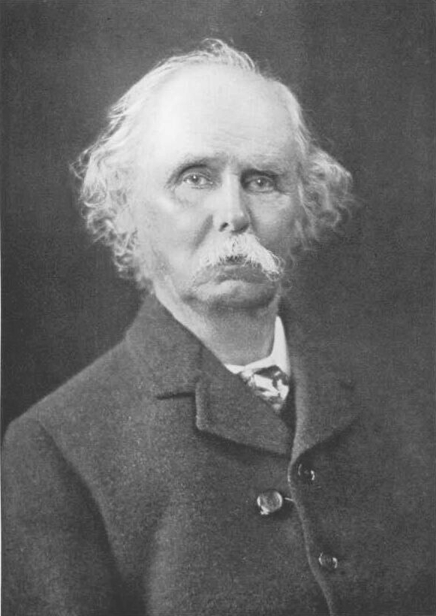
The Marginalist Revolution
William Stanley Jevons 1835-1882
Carl Menger 1840-1921
Alfred Marshall 1842-1924
Léon Walras 1834-1910

Slide 64
Be that as it may
A theorem such as:
For a relation$≽$ on a finite set $X$
$≽$ is complete and transitive
IFF
There exists $u:X→\left(−∞,∞\right)$ that represents $≽$
endows “utility” with meaning

Slide 65
Interpretation II: normative
Suppose you ask me how to make a decision
And I ask you, would you like your $≽$ to be complete ?
Many would say yes
Incompleteness is absence of decision (Kafka and his wedding engagements…)
And then: would you like your $≽$ to be transitive ?
Again, many would say yes
An intransitive relation, let’s say a cyclical one (that’s more than just intransitive!) isn’t very useful

Slide 66
The normative interpretation – cont.
And then I point out to you that
For a relation$≽$ on a finite set $X$
$≽$ is complete and transitive
IFF
There exists $u:X→\left(−∞,∞\right)$ that represents $≽$
And I can convince you that you would like to behave as if you were maximizing a utility function, or maybe just maximize one (consciously)

Slide 67
Interpretation III: descriptive
Suppose I tell you that, when I analyze an economic problem, I assume that agents are utility maximizing.
Does it make sense?
Do you know many such agents?
What gives me the right to make predictions and give advice based on such a preposterous assumption?

Slide 68
The descriptive interpretation – cont.
And then I point out to you that
For a relation$≽$ on a finite set $X$
$≽$ is complete and transitive
IFF
There exists $u:X→\left(−∞,∞\right)$ that represents $≽$
… and I may convince you that more agents might be described by my analysis than you would have imagined

Slide 69
Comments
Why do I need to convince you that this is how people behave?
Why not just test?
Indeed, if we test, it doesn’t matter which formulation we use
The whole point is that they’re equivalent
In fact, a characterization theorem is a sort of a framing effect
If economics were a successful science, it would not need axiomatizations
But it isn’t so successful. So it leaves room for rhetoric.

Slide 70
Compare with Social Choice
For a relation$≽$ on a finite set $X$
$≽$ is complete and transitive
IFF
There exists $u:X→\left(−∞,∞\right)$ that represents$≽$
Pareto domination: transitive but not complete
Majority vote: complete but not transitive

Slide 71
Pareto Domination
Basically, unanimity
(At least one has strict preference, the others – weak [or strict] )
Transitivity seems obvious
(A bit involved because of this “at least one strict” issue)
But completeness is utopian

Slide 72
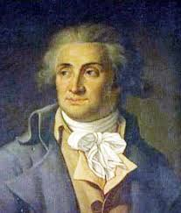
Majority vote
Condorcet showed that even if all individuals have complete and transitive preferences, the majority vote of them as a society might not be transitive
Marie Jean Antoine Nicolas de Caritat, Marquis of Condorcet (1743-1794)

Slide 73
Condorcet’s Paradox
Individuals $1,2,3$ ; alternatives $x,y,z$
Preferences are given by:
$$1$$ | $$2$$ | $$3$$
$$x$$ | $$y$$ | $$z$$
$$y$$ | $$z$$ | $$x$$
$$z$$ | $$x$$ | $$y$$

Slide 74
Condorcet’s Paradox – cont.
Majority vote:
$$1$$ | $$2$$ | $$3$$
$$x$$ | $$y$$ | $$z$$
$$y$$ | $$z$$ | $$x$$
$$z$$ | $$x$$ | $$y$$
$$x$$
$$2,3$$
$$1,3$$
$$z$$
$$y$$
$$1,2$$

Slide 75
The social choice perspective
Shows that it isn’t trivial to assume that a relation$≽$ is complete and transitive
 | complete | transitive
Pareto domination | $$−$$ | +
Majority vote | + | $$−$$

Slide 76
Indeed, it can happen in one’s mind
If we have different criteria for decision making, and we’re trying to aggregate them
Each can be thought of as an “individual”
Looking for unanimity we may not get completeness
Using majority – we may lose transitivity
The representation result suggests we should aggregate by a numerical trade-off

Slide 77
Is the utility unique?
…There exists and a function $u:X→\left(−∞,∞\right)$ that represents$≽$
Can we say that we found the utility of the consumer?
Well, all we asked is
$x≽y iff u(x)≥u(y)$
So $v\left(x\right)=10u\left(x\right)$ could also work

Slide 78
How unique is the utility?
OK,
$v\left(x\right)=10u\left(x\right)$
is just a change of the unit of measurement – we’re used to that
And
$v^{′}\left(x\right)=10u\left(x\right)+15$
Also involves “shifting” the zero; as in temperature

Slide 79
Cardinal utility
If the data allow for any transformation
$v\left(x\right)=au\left(x\right)+b$
where $a>0$ , but only those, we say that $u$ is cardinal
As in
$$F\left(x\right)=\frac{9}{5}C\left(x\right)+32$$
$$C\left(x\right)=\frac{5}{9}F\left(x\right)−\frac{160}{9}$$

Slide 80
But
For
$x≽y iff u(x)≥u(y)$
to hold we can also use
$$v\left(x\right)={\left[u\left(x\right)\right]}^{3}$$
$$v\left(x\right)=log\left[u\left(x\right)\right]$$
if $u\left(x\right)>0$
And many others. The function $u\left(x\right)$ is only ordinal.

Slide 81
Conditions for utility representation – beyond finite
For a relation $≽$ on a countable set $X$,
$≽$ is complete and transitive
IFF
There exists and a function $u:X→\left(−∞,∞\right)$ that represents$≽$

Slide 82
Conditions for utility representation – beyond countable
But: let $\left(a,b\right)≽(a^{′},b^{′})$ iff
$$a>a^{′}$$
or [ $a=a^{′}$ and $b≥b′$ ]
It is complete and transitive

Slide 83
Lexicographic preferences
Complete?
Transitive?
… but has no representation by any real-valued function
$$(a^{′},b^{′})$$
$$(a,b)$$

Slide 84
Why is there no representation?
If there were, we would need to have an entire (positive length) interval of utility values between
$$u\left(\left(a,0\right)\right) and u\left(\left(a^{′},1\right)\right)$$
For any
$$a^{′}>a$$
Which is a bit too much for the real line (as the $u$ range) to carry
$$(a^{′},1)$$
$$(a,0)$$

Slide 85
Continuity
The relation$≽$ is continuous iff $x_{n}→x$ implies that
$x≽y$ whenever ($x_{n}≽y$ for all $n$)
and
$x≼y$ whenever ($x_{n}≼y$ for all $n$)

Slide 86
Continuity is very reasonable
If $x_{n}→x$ then $x≽y$ whenever ($x_{n}≽y$ for all $n$)
and
$x≼y$ whenever ($x_{n}≼y$ for all $n$)
Almost everything we can think of, in terms of physical and physiological mechanisms, is continuous
An exception: a vegetarian’s preferences for the amount of meat
More generally, meaning may behave discontinuously

Slide 87
Lexicographic preferences aren’t continuous
For any such $a$,
$x_{n}≽y$ for all $n$
But
$$x≽y$$
does not hold – we have
$$y≻x$$
$$y=(a,1)$$
$$x_{n}=(a+\frac{1}{n},0)$$
$$x=(a,0)$$

Slide 88
Is continuity reasonable, then?
I would argue that the lexicographic preferences don’t typically appear in reality – apart from the case of endowing quantities with meaning
They do appear in speeches (“we will never risk human lives, but, given that, we will…”)
This may say more about the speeches than about real preferences
Anyway…

Slide 89
Continuous utility representation
For a relation$≽$ on $R^{k}$,
$≽$ is complete, transitive, and continuous
IFF
There exists and a continuous function $u:X→\left(−∞,∞\right)$ that represents $≽$

Slide 90
Background: Countable and uncountable sets

Slide 91
A puzzle
You run a hotel with infinitely many rooms
$$ℕ=\left\{1,2,3,…\right\}$$
They’re all occupied, and a new person comes along and asks to be hosted
Can you give them a room?

Slide 92
Well, you can:
We start with
$$ℕ=\left\{1,2,3,…\right\}$$
And, say, person $0$
The set
$$ℕ∪\left\{0\right\}=\left\{0,1,2,3,…\right\}$$
has “as many elements” as $ℕ=\left\{1,2,3,…\right\}$

Slide 93
“As many elements as’’
We can have a 1-1 mapping between
$$ℕ=\left\{1,2,3,…\right\}$$
and
$$ℕ∪\left\{0\right\}=\left\{0,1,2,3,…\right\}$$
$$ℕ$$ | $$1$$ | $$2$$ | $$3$$ | $$4$$ | $$5$$ | $$…$$
$$ℕ∪\left\{0\right\}$$ | $$0$$ | $$1$$ | $$2$$ | $$3$$ | $$4$$ | $$…$$

Slide 94
What about all the integers?
Again, we can have a 1-1 mapping between
$$ℕ=\left\{1,2,3,…\right\}$$
and
$$ℤ=\left\{0, 1,−1, 2,−2, 3,−3,…\right\}$$
$$ℕ$$ | $$1$$ | $$2$$ | $$3$$ | $$4$$ | $$5$$ | $$…$$
$$ℤ$$ | $$0$$ | $$1$$ | $$−1$$ | $$2$$ | $$−2$$ | $$…$$

Slide 95
And the rationals?
$$ℚ=\left\{ \frac{a}{b} | a,b∈ℕ∪\left\{0\right\}\text{,} b≠0\right\}$$
And it turns out they can be “counted” too. Consider $a,b>0$
$$b$$ $$a$$ | $$1$$ | $$2$$ | $$3$$ | $$4$$ | $$5$$ | $$…$$
$$1$$ | $$\frac{1}{1}=1$$ | $$\frac{1}{2}$$ | $$\frac{1}{3}$$ | $$\frac{1}{4}$$ | $$\frac{1}{5}$$ | $$…$$
$$2$$ | $$\frac{2}{1}=2$$ | $$\frac{2}{2}=1$$ | $$\frac{2}{3}$$ | $$\frac{2}{4}=\frac{1}{2}$$ | $$\frac{2}{5}$$ | $$…$$
$$3$$ | $$\frac{3}{1}=3$$ | $$\frac{3}{2}$$ | $$\frac{3}{3}=1$$ | $$\frac{3}{4}$$ | $$\frac{3}{5}$$ | $$…$$
$$4$$ | $$\frac{4}{1}=4$$ | $$\frac{4}{2}=2$$ | $$\frac{4}{3}$$ | $$\frac{4}{4}=1$$ | $$\frac{4}{5}$$ | $$…$$
$$5$$ | $$\frac{5}{1}=5$$ | $$\frac{5}{2}$$ | $$\frac{5}{3}$$ | $$\frac{5}{4}$$ | $$\frac{5}{5}=1$$ | $$…$$
$$…$$ | $$…$$ | $$…$$ | $$…$$ | $$…$$ | $$…$$ | $$…$$

Slide 96
For any table…
We can count the cells…
 | $$1$$ | $$2$$ | $$4$$ | $$7$$ | $$…$$ | $$…$$
 | $$3$$ | $$5$$ | $$8$$ | $$…$$ |  | $$…$$
 | $$6$$ | $$9$$ | $$…$$ |  |  | $$…$$
 | $$10$$ | $$…$$ |  |  |  | $$…$$
 |  |  |  |  |  | $$…$$
 | $$…$$ | $$…$$ | $$…$$ | $$…$$ | $$…$$ | $$…$$

Slide 97
And thus
$ℚ=\left\{ \frac{a}{b} | a,b∈ℕ \text{,} b≠0\right\}$ can be “counted”, too
$$b$$ $$a$$ | $$1$$ | $$2$$ | $$3$$ | $$4$$ | $$5$$ | $$…$$
$$1$$ | $$\frac{1}{1}=1$$ | $$\frac{1}{2}$$ | $$\frac{1}{3}$$ | $$\frac{1}{4}$$ | $$\frac{1}{5}$$ | $$…$$
$$2$$ | $$\frac{2}{1}=2$$ | $$\frac{2}{2}=1$$ | $$\frac{2}{3}$$ | $$\frac{2}{4}=\frac{1}{2}$$ | $$\frac{2}{5}$$ | $$…$$
$$3$$ | $$\frac{3}{1}=3$$ | $$\frac{3}{2}$$ | $$\frac{3}{3}=1$$ | $$\frac{3}{4}$$ | $$\frac{3}{5}$$ | $$…$$
$$4$$ | $$\frac{4}{1}=4$$ | $$\frac{4}{2}=2$$ | $$\frac{4}{3}$$ | $$\frac{4}{4}=1$$ | $$\frac{4}{5}$$ | $$…$$
$$5$$ | $$\frac{5}{1}=5$$ | $$\frac{5}{2}$$ | $$\frac{5}{3}$$ | $$\frac{5}{4}$$ | $$\frac{5}{5}=1$$ | $$…$$
$$…$$ | $$…$$ | $$…$$ | $$…$$ | $$…$$ | $$…$$ | $$…$$
 | $$1$$ | $$2$$ | $$4$$ | $$7$$ | $$…$$ | $$…$$
 | $$3$$ | $$5$$ | $$8$$ | $$…$$ |  | $$…$$
 | $$6$$ | $$9$$ | $$…$$ |  |  | $$…$$
 | $$10$$ | $$…$$ |  |  |  | $$…$$
 |  |  |  |  |  | $$…$$
 | $$…$$ | $$…$$ | $$…$$ | $$…$$ | $$…$$ | $$…$$

Slide 98
So it turns out that
The naturals $ℕ=\left\{1,2,3,…\right\}$
the integers $ℤ=\left\{0, 1,−1, 2,−2, 3,−3,…\right\}$
and the rationals $ℚ=\left\{ \frac{a}{b} | a,b∈ℤ\text{,} b≠0\right\}$
all have “as many elements as” each other
They are all countable

Slide 99
Admittedly, it’s weird…
That a set
$$ℕ=\left\{1,2,3,…\right\}$$
would have “as many elements as” supersets thereof
$$ℤ=\left\{0, 1,−1, 2,−2, 3,−3,…\right\}$$
$$ℚ=\left\{ \frac{a}{b} | a,b∈ℤ\text{,} b≠0\right\}$$
But we simply don’t have a better definition of the (same) “number of elements” for infinite sets

Slide 100
And it can also happen with intervals
That a set $\left[0,1\right]$
has “as many elements as” its superset $\left[0,2\right]$
In fact,
$$f\left(x\right)=0.5x$$
is a 1-1 mapping from $\left[0,2\right]$ to $\left[0,1\right]$
$$\left[0,1\right]$$
$$\left[0,2\right]$$

Slide 101
Any two intervals
would clearly have the same “number of elements” (“cardinality”)
In fact,
$$f\left(x\right)=c+\frac{d−c}{b−a}\left(x−a\right)$$
is a 1-1 mapping from $\left[a,b\right]$ to $\left[c,d\right]$
$$\left[c,d\right]$$
$$\left[a,b\right]$$

Slide 102
Even infinite and finite
And even the non-negative part of the line $[0,∞)$ has the same cardinality:
$$f\left(x\right)=1−e^{−x}$$
is a 1-1 mapping from $[0,∞)$
to $[0,1)$

Slide 103
And since we have
mappings from the entire line$ℝ=\left(−∞,∞\right)$ into $\left[−1,1\right]$, such as
$f\left(x\right)=arctg(x)$

Slide 104
All intervals
of positive length have the same “number of elements” (“cardinality”)
Because
$$f\left(x\right)=\frac{1}{2}\left(arctg(x)\text{+}\text{1}\right)$$
is a 1-1 mapping from$ℝ=\left(−∞,∞\right)$
into $\left[0,1\right]$

Slide 105
So maybe all infinities are the same?
Maybe the reals $ℝ=\left(−∞,∞\right)$
are also countable?
Is there a 1-1 mapping from the reals to
the naturals $ℕ=\left\{1,2,3,…\right\}$?

Slide 106
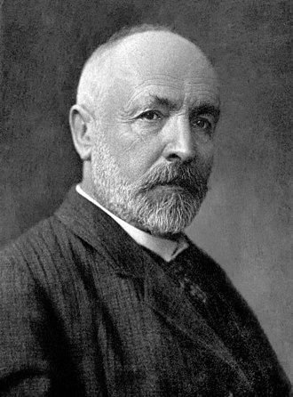
Well, they aren’t
Even $\left[0,1\right]⊂ℝ=\left(−∞,∞\right)$
isn’t countable
There is no 1-1 mapping from the reals to
the naturals $ℕ=\left\{1,2,3,…\right\}$
Georg Cantor (1845-1918)

Slide 107
$\left[0,1\right]$ isn’t countable
Assume it were
Then we’d have $\left[0,1\right]=\left\{x_{1},x_{2},x_{3},x_{4},…\right\}$
For each $x∈\left[0,1\right]$ there is $n≥1$such that $x=x_{n}$
Each $x_{i}$ can be written in a decimal expansion (not always in a unique way):
$$x_{i}=0. {d_{1}^{i}d}_{2}^{i}d_{3}^{i}d_{4}^{i}d_{5}^{i}…$$
Where $d_{j}^{i}∈\left\{0,1,2,,…,9\right\}$

Slide 108
If $\left[0,1\right]$ were countable
We’d have
$$x_{1}=0. {d_{1}^{1}d}_{2}^{1}d_{3}^{1}d_{4}^{1}…$$
$$x_{2}=0. {d_{1}^{2}d}_{2}^{2}d_{3}^{2}d_{4}^{2}…$$
$$x_{3}=0. {d_{1}^{3}d}_{2}^{3}d_{3}^{3}d_{4}^{3}…$$
$$x_{4}=0. {d_{1}^{4}d}_{2}^{4}d_{3}^{4}d_{4}^{4}…$$
We can construct
$$x=0.{b_{1}b}_{2}b_{3}b_{4}…$$
with $b_{i}=d_{i}^{i}+2(mod 10)$ so that $x≠x_{i}$ – for all $i$

Slide 109
Why $d_{i}^{i}+2$ ?
The decimal expansion isn’t unique
$$\frac{1}{2}=0. 500000…$$
$$\frac{1}{2}=0. 499999…$$
so that fact that $d_{i}^{i}≠d_{i}^{j}$ isn’t yet a proof that $x_{i}$ $≠x_{j}$
… but we get the point

Slide 110
Consumer theory

Slide 111
Consumer theory: Basic concepts and preview

Slide 112
A basic distinction
What we can do and what we want to do are logically independent
Aesop’s fox: “sour grapes”
Groucho Marx: “I refuse to join any club that would have me for a member”
The fox is psychologically healthier
But they both commit the same “rationality sin”
And a converse one is “wishful thinking”

Slide 113
What can we choose
$x$ – quantity of good 1
$y$ – quantity of good 2
$p_{x}$ – price of good 1
$p_{y}$ – price of good 2
$I$ – income
decision variables – what is up to us to control
feasible set – what are the possible values we may choose for these variables

Slide 114
The budget constraint
$$y$$
$$\frac{I}{p_{y}}$$
$$p_{y}y+p_{x}x≤I$$
$$x,y≥0$$
$$x$$
$$\frac{I}{p_{x}}$$

Slide 115
The objective function
$$y$$
Maximization of utility : $Max U(x,y)$
We thus ask, which of the points in the feasible set has the highest $U$ value?
$$\frac{I}{p_{y}}$$
$$x$$
$$\frac{I}{p_{x}}$$

Slide 116
Indifference curves
Even with two goods, it’s hard to visualize the utility : $Max U(x,y)$
In fact, because utility is only ordinal, it’s not clear we want to visualize it
The information we’d miss is not very meaningful anyway…

Slide 117
Indifference curves
$$y$$
Connect points with equal utility
$$U\left(x,y\right)=c$$
Each is an indifference class of $≽$
$$x$$

Slide 118
Optimization
$$y$$
$$\frac{I}{p_{y}}$$
Match the indifference curves with the feasible set
Try to find the highest indifference curve you can still be on
$$x$$
$$\frac{I}{p_{x}}$$

Slide 119
Sneak preview
Optimality is often found at the equality of slopes which will be identified by the marginality condition:
$$\frac{U_{x}}{U_{y}}=\frac{p_{x}}{p_{y}}$$
or
$$\frac{U_{x}}{p_{x}}=\frac{U_{y}}{p_{y}}$$

Slide 120
The marginality condition
$$y$$
A basic optimization tool: look for a point with equal slopes
Generally, neither necessary nor sufficient, but let’s see its logic first
$$\frac{I}{p_{y}}$$
$$x$$
$$\frac{I}{p_{x}}$$

Slide 121
Why equate slopes?
$$y$$
If the budget line is steeper than the indifference curve…
$$\frac{I}{p_{y}}$$
$$x$$

Slide 122
Why equate slopes?
$$y$$
If the indifference curve is steeper than the budget line…
$$\frac{I}{p_{y}}$$
$$x$$

Slide 123
The slope of the budget constraint
$p_{x}x+p_{y}y=I$
$p_{x}\left(x+a\right)+p_{y}\left(y−b\right)=I$
$p_{x}a−p_{y}b=0$
$\frac{b}{a}= \frac{p_{x}}{p_{y}}$
$$y$$
$$b$$
$$a$$
$$x$$

Slide 124
The slope of the indifference curve
$$U\left(x,y\right)=c$$
$$U\left(x+a,y−b\right)=c$$
$$U_{x}a − U_{y}b ≅0$$
$$\frac{b}{a} ≅ \frac{U_{x}}{U_{y}}$$
$$U\left(x,y\right)=c$$
$$y$$
$$b$$
$$a$$
$$x$$

Slide 125
… So, we want equality of slopes:
$$\frac{U_{x}}{U_{y}}=\frac{p_{x}}{p_{y}}$$
$$\frac{U_{x}}{p_{x}}=\frac{U_{y}}{p_{y}}$$
or:

Slide 126
The economic meaning of the marginality condition
$\$1≅ \frac{1}{p_{x}}$ units of $x ≅\frac{U_{x}}{p_{x}}$ utility
$\$1≅\frac{1}{p_{y}}$ units of $y ≅\frac{U_{y}}{p_{y}}$ utility

Slide 127
Thus…
If:
$$\frac{U_{x}}{p_{x}}>\frac{U_{y}}{p_{y}}$$
we’ll be better off moving $1 from $y$ to$x$
$$\frac{U_{x}}{p_{x}}<\frac{U_{y}}{p_{y}}$$
And vice versa if
Unless…

Slide 128
Unless this is impossible, say
$$\frac{U_{x}}{p_{x}}>\frac{U_{y}}{p_{y}}$$
and
$$y=0$$
… which can happen (“corner solution”)

Slide 129
Example
$x−$ # of six-pack of water bottles
$y−$ # of single water bottles
$p_{x}=15−$ price for a six-pack
${ p}_{y}=3−$ price for a single
$I=60$ $−$budget for water

Slide 130
The budget constraint
$$y$$
$$15x+3y≤60$$
$\left(x,y\right)$ – a bundle
$$\frac{I}{p_{y}}=\frac{60}{3}=20$$
$$\frac{I}{p_{x}}=\frac{60}{15}=4$$
$$x$$

Slide 131
Example: linear utility
For example
$$U(x,y) =6x +y$$
Which can happen:
$x$ = six-packs of bottles
$y$ = single bottles
For such a function corner solutions will not be exceptional

Slide 132
Graphically
$$U(x,y) =6x +y$$
$$y$$
The six-packs are a better deal:
$p_{x}=15<6∗3=6p_{y}$
Comparing the slopes:
$U_{x}=6,U_{y}=1$
$$\frac{I}{p_{y}}=20$$
$$\frac{p_{x}}{p_{y}}=\frac{15}{3}=5<6= \frac{U_{x}}{U_{y}}$$
$$\frac{U_{y}}{p_{y}}=\frac{1}{3}<\frac{6}{15}=\frac{U_{x}}{p_{x}}$$
$$\frac{I}{p_{x}}=4$$
$$x$$

Slide 133
What is exactly meant by${ U}_{x}=6,U_{y}=1$?
A partial derivative of a function is the derivative relative to one variable while the others are held fixed
The partial derivative of $U(x,y)$ relative to $x$ :
$\frac{∂U}{∂x}(x,y)$= ${\frac{∂U(x,y)}{∂x}\text{ =} U}_{x}(x,y)$
and relative to $y$ :
$\frac{∂U}{∂y}(x,y)$= ${\frac{∂U(x,y)}{∂y}\text{ = }U}_{y}(x,y)$

Slide 134
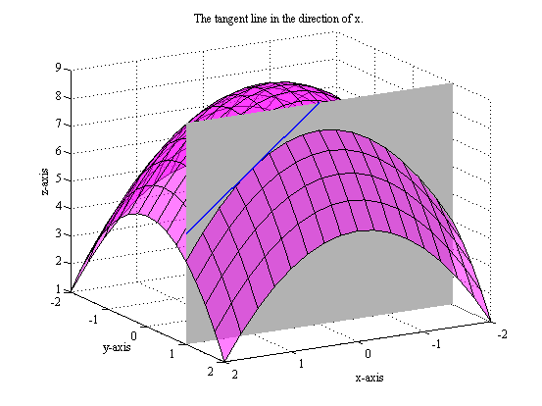
Partial derivatives graphically

Slide 135
Examples of partial derivatives
For
$$U\left(x,y\right)=ax+by$$
The partial derivatives are
$${ U}_{x}\left(x,y\right)=a$$
$${ U}_{y}\left(x,y\right)=b$$
And for
$$U\left(x,y\right)=axy$$
We get
$${ U}_{x}\left(x,y\right)=ay$$
$${ U}_{y}\left(x,y\right)=ax$$

Slide 136
The economic meaning of
$$\frac{U_{y}}{p_{y}}< \frac{U_{x}}{p_{x}}$$
$\$1≅ \frac{1}{p_{x}}$ units of $x ≅\frac{U_{x}}{p_{x}}$ utility
$\$1≅\frac{1}{p_{y}}$ units of $y ≅\frac{U_{y}}{p_{y}}$ utility

Slide 137
We could also have…
$$U(x,y) =6x +y$$
$$y$$
And if $p_{x}>6p_{y}$
$$\frac{I}{p_{y}}$$
$$\frac{p_{x}}{p_{y}}>6= \frac{U_{x}}{U_{y}}$$
Can $p_{x}>6p_{y}$ happen???
$$\frac{I}{p_{x}}$$
$$x$$

Slide 138
Finally…
$$U(x,y) =6x +y$$
$$y$$
If $p_{x}=6p_{y}$
$$\frac{I}{p_{y}}$$
$$\frac{p_{x}}{p_{y}}=6= \frac{U_{x}}{U_{y}}$$
No unique solution
(isn’t it a knife-edge case?)
$$\frac{I}{p_{x}}$$
$$x$$

Slide 139
Summing up
The solution to the water consumption problem is:
$$\begin{aligned}\left(x,y\right)= \left(\frac{I}{p_{x}},0\right) \\ \\ \left(x,y\right)= \left(0, \frac{I}{p_{y}}\right) \end{aligned}$$
If $\frac{p_{x}}{p_{y}}<6$
If $\frac{p_{x}}{p_{y}}>6$
$$\begin{aligned}\left[\left(\frac{I}{p_{x}},0\right),\left(0,\frac{I}{p_{y}}\right)\right] \\ \\ \end{aligned}$$
And if $\frac{p_{x}}{p_{y}}=6$ – anywhere in

Slide 140
Decreasing marginal utility
In the water bottles problems, the marginal utilities were constant
It might be more intuitive that the “extra utility” we get from a good decreases as we have more of it

Slide 141
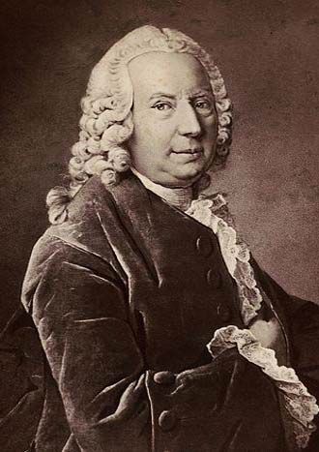
The utility from money
Back in 1738, Daniel Bernoulli wrote,
“And, because the marginal utility from money is in inverse proportion to the amount of money we have…”
Daniel Bernoulli 1700-1782

Slide 142
“The marginal utility is inversely proportional…”
$u′\left(x\right)=c∗ \frac{1}{x}$ $c>0$
$u\left(x\right)=c∗\log\left(x\right)+d$ $c>0$
$$log⁡(x)=lan(x)$$

Slide 143
But what do you mean, Daniel?
Rudolf Carnap (1891-1970)
Karl Popper (1902-1994)
Theoretical terms should be defined by observations
How do you measure this “marginal utility”???

Slide 144
Two possible answers:
Look, guys, you’re going to talk about this 200 years after me. Com’n.
In between us, there will be a psychologist who will show that more is observable than what these economists will choose to admit
Daniel Bernoulli 1700-1782

Slide 145
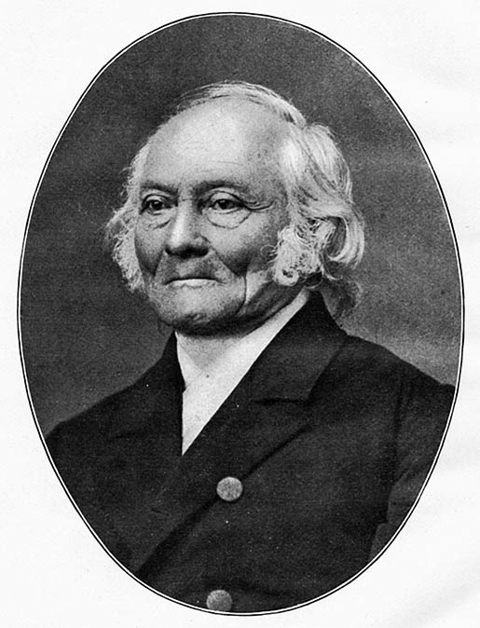
Weber’s law in psychophysics
Ernst Heinrich Weber
1795-1878
$$\frac{∆S}{S}=λ$$
$S$– stimulus
$∆S$– increase in the stimulus (that can be discerned with a fixed probability, usually 75%)
$λ$ – a positive constant

Slide 146
Weber’s law – cont.
A person would notice, with probability 75% or more, that a change has occurred, namely that
$$S+∆S>S$$
Only if the physical change is large enough
$$\frac{S+∆S}{S}>1+λ$$
Or:
$$log\left(S+∆S\right)−log\left(S\right)>log\left(1+λ\right)$$
– a constant

Slide 147
The $log$ function
Hence, for physical quantities, the $log$ function plays a special role
$$log(x)$$
$$x$$

Slide 148
A comment re $log$
Unless otherwise stated, we’ll take the base of $log$to be $e$
$$log⁡(x)=lan(x)$$
$$log⁡(x)$$
Recall that any other base $a$ $>1$ is a positive multiple thereof :
$$\log_{a}(x)=\frac{\log_{e}(x)}{\log_{e}(a)}=γlan(x)$$
for
$γ=\frac{1}{\log_{e}(a)}$ $= \frac{1}{lan(a)}$ $>0$
$$x$$

Slide 149
Cobb-Douglas Preferences (After Charles Cobb, Paul Douglas)
We started with $U\left(x,y\right)=6x+y$
Or, more generally, a linear function:
$$U\left(x,y\right)=ax+by a,b>0$$
We can now look at a simple function that allows for decreasing marginal utility:
$$U\left(x,y\right)=alog(x)+blog(y) a,b>0$$

Slide 150
Indifference curves for Cobb-Douglas
$U\left(x,y\right)=alog(x)+blog(y)$
$$y$$
For example, for $a=b=1$
$$U\left(x,y\right)=log⁡(x)+log⁡(y)=\log\left(xy\right)$$
$$U\left(x,y\right)=c$$
$$⟺$$
$$\log\left(xy\right)=c$$
$$⟺$$
$$xy=d$$
$$U=c_{2}$$
$$U=c_{1}$$
$$x$$

Slide 151
Decreasing marginal utility
$$y$$
Suppose
$$U\left(x,y\right)=\log_{10}\left(x\right)+\log_{10}\left(y\right)$$
Consider the indifference curve
$$U\left(x,y\right)=\log_{10}\left(x\right)+\log_{10}\left(y\right)=3$$
$$xy=1000$$
and two points on it
$$\left(10,100\right),(100,10)$$
100
10
$$x$$
10
100

Slide 152
Indifference curves become less steep (going from left to right)
$$y$$
Imagine that at $\left(10,100\right)$ we reduce $y$ by 1. How much $x$ should we add to compensate for this reduction?
100
10
$$x$$
10
100

Slide 153
Let’s use the partial derivatives
$$U\left(x,y\right)=\log_{10}\left(x\right)+\log_{10}\left(y\right)$$
And thus
$$U_{x}\left(x,y\right)={log′}_{10}\left(x\right)=\frac{γ}{x}$$
$$U_{y}\left(x,y\right)={log′}_{10}\left(y\right)=\frac{γ}{y}$$
(For $γ=1/lan(10)$ )

Slide 154
At $\left(10,100\right)$
The partial derivatives (marginal utilities) are
$\frac{γ}{x}$ = $\frac{γ}{10}$ $\frac{γ}{y}$ = $\frac{γ}{100}$
As $y$ decreases from 100 to 99 the utility loss is approximately $\frac{γ}{100}$ and in order to compensate fot that we need extra $a$ of product 1 (increase $x$) that satisfies, roughly,
$\frac{γ}{10}$ $a$= $\frac{γ}{100}$
$a$= $\frac{1}{10}$
$$y$$
100
10
$$x$$
10
100

Slide 155
By contrast, at $\left(100,10\right)$
The partial derivatives (marginal utilities) are
$\frac{γ}{x}$ = $\frac{γ}{100}$ $\frac{γ}{y}$ = $\frac{γ}{10}$
As $y$ decreases from 10 to 9 the utility loss is approximately $\frac{γ}{10}$ and in order to compensate fot that we need extra $a$ of product 1 (increase $x$) that satisfies, roughly,
$\frac{γ}{100}$ $a$= $\frac{γ}{10}$
$a$= $10$
$$y$$
100
10
$$x$$
10
100

Slide 156
A general point
$$y$$
When the marginal utility of each product is decreasing, we will have indifference curves that are less steep as we go from upper left to lower right
$$x$$

Slide 157
Optimal solution for CD preferences
$$U\left(x,y\right)=alog\left(x\right)+blog\left(y\right)$$
$$U_{x}= \frac{a}{x},{ U}_{y}= \frac{b}{y}$$
$$\frac{U_{x}}{U_{y}}= \frac{\frac{a}{x}}{\frac{b}{y}}= \frac{a}{b}\frac{y}{x}$$
$$y$$
$$\frac{I}{p_{y}}$$
$$x$$
$$\frac{I}{p_{x}}$$

Slide 158
The slope of the indifference curves for CD
$$y$$
When $x$ tends to 0 (and $y$ doesn’t) they become very steep
When $y$ tends to 0 (and $x$ doesn’t) they become very flat
The slope is the same along any ray from the origin (homothetic preferences)
$$x$$

Slide 159
Homothetic preferences
$$y$$
Along every ray that starts at the origin $(0,0)$, the slope of all indifference curves is the same
But it can change from one ray to another
$$x$$

Slide 160
Solving the CD problem – cont.
Looking for $\left(x,y\right)$ where:
$$p_{x}x+p_{y}y=I$$
and
$$\frac{U_{x}}{U_{y}}=\frac{p_{x}}{p_{y}}$$
or
$$\frac{a}{b}\frac{y}{x}=\frac{p_{x}}{p_{y}}$$

Slide 161
Solving the CD problem – cont.
$$\frac{a}{b}\frac{y}{x}=\frac{p_{x}}{p_{y}}⟹\frac{p_{x}x}{p_{y}y}=\frac{a}{b}$$
Let’s denote
$$E_{x}=p_{x}x$$
$$E_{y}=p_{y}y$$
So that
$$\frac{E_{x}}{E_{y}}=\frac{a}{b}$$
which has to hold for all $p_{x},p_{y}$ $,I$ !

Slide 162
Solving the CD problem – nearly done…
$$\frac{E_{x}}{E_{y}}=\frac{a}{b}$$
$$E_{x}+E_{y}= p_{x}x+p_{y}y=I$$
Hence
$$E_{x}= \frac{a}{a+b}I$$
$$E_{y}= \frac{b}{a+b}I$$

Slide 163
(Was that too quick?)
$$\frac{E_{x}}{E_{y}}=\frac{a}{b}{ ⟹ E}_{x}=\frac{a}{b}E_{y}$$
Plug these in
$$E_{x}+E_{y}= p_{x}x+p_{y}y=I$$
to get
$$\frac{a}{b}E_{y}+E_{y}=\left(\frac{a}{b}+1\right)E_{y}=\frac{a+b}{b}E_{y}=I$$
and thus
$$E_{y}= \frac{b}{a+b}I$$
and
$$E_{x}=I−E_{y}=I−\frac{b}{a+b}I=\frac{a}{a+b}I$$

Slide 164
Solving the CD problem – wrapping up
$$E_{x}=p_{x}x= \frac{a}{a+b}I$$
$$⟹x= \frac{a}{a+b}\frac{1}{p_{x}}I$$
$$E_{y}=p_{y}y= \frac{b}{a+b}I$$
$$⟹y= \frac{b}{a+b}\frac{1}{p_{y}}I$$

Slide 165
Consumer theory: Lagrange Multipliers

Slide 166
Or, using Lagrange multipliers
The “real” problem
$${Max}_{x,y} U\left(x,y\right)$$
$$p_{x}x+p_{y}y≤I$$
$$x,y≥0$$

Slide 167
Simplify our lives
$$y$$
If $U$ is monotone (the consumer prefers more to less), it’s safe to assume the solution will be on
$$p_{x}x+p_{y}y=I$$
$$\frac{I}{p_{y}}$$
Can’t be optimal
$$\frac{I}{p_{x}}$$
$$x$$

Slide 168
Let’s simplify our lives even further
Let’s ignore the non-negativity constraints
$$x,y≥0$$
(Make a mental note not to forget these)
And then there’s only one constraint, which is an equality:
$${Max}_{x,y} U\left(x,y\right)$$
$$s.t. p_{x}x+p_{y}y=I$$

Slide 169
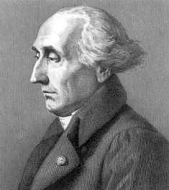
Lagrange’s idea
We’ll build the constraint into the utility function
As if it could be violated, though at a cost
At the optimal solution it won’t be violated after all
But the trick will also have an economic meaning
Joseph-Louis Lagrange 1736-1813

Slide 170
Solving using Lagrange multiplier
$${Max}_{x,y} U\left(x,y\right)$$
$$s.t. p_{x}x+p_{y}y=I$$
Becomes
$${Max}_{x,y,λ} ℒ\left(x,y,λ\right)$$
$$ℒ\left(x,y,λ\right)=U\left(x,y\right)−λ[p_{x}x+p_{y}y−I]$$
𝜆 – a new variable, the cost of violating the constraint

Slide 171
Lagrange’s method – cont.
To find ${Max}_{x,y,λ} ℒ\left(x,y,λ\right)$
we take all partial derivatives and set them to zero
$$\frac{∂ℒ(x,y,λ)}{∂x}=0$$
$$\frac{∂ℒ(x,y,λ)}{∂y}=0$$
$$\frac{∂ℒ(x,y,λ)}{∂λ}=0$$

Slide 172
The partial derivatives
$$ℒ\left(x,y,λ\right)=U\left(x,y\right)−λ[p_{x}x+p_{y}y−I]$$
$$\frac{∂ℒ}{∂x}= U_{x}−λp_{x}$$
$$\frac{∂ℒ}{∂y}= U_{y}−λp_{y}$$
$$\frac{∂ℒ}{∂λ}=− [p_{x}x+p_{y}y−I]$$

Slide 173
Setting them to zero
$$\frac{∂ℒ}{∂x}= U_{x}−λp_{x}=0$$
$$\frac{∂ℒ}{∂y}= U_{y}−λp_{y}=0$$
$$\frac{∂ℒ}{∂λ}=− \left[p_{x}x+p_{y}y−I\right]=0$$

Slide 174
The resulting equations
$$\frac{∂ℒ}{∂x}=0= U_{x}−λp_{x}⟹λ=\frac{U_{x}}{p_{x}}$$
$$\frac{∂ℒ}{∂y}=0= U_{y}−λp_{y}⟹λ=\frac{U_{y}}{p_{y}}$$
$$\frac{∂ℒ}{∂λ}=0=− \left[p_{x}x+p_{y}y−I\right]⟹p_{x}x+p_{y}y=I$$

Slide 175
Conclusions
$$\frac{∂ℒ}{∂λ}=0⟹p_{x}x+p_{y}y=I$$
$$\frac{∂ℒ}{∂x}=0 ⟹λ=\frac{U_{x}}{p_{x}}$$
$$\frac{∂ℒ}{∂y}=0 ⟹λ=\frac{U_{y}}{p_{y}}$$
$$\frac{U_{x}}{p_{x}}=\frac{U_{y}}{p_{y}}$$
$$\frac{U_{x}}{p_{x}}=\frac{U_{y}}{p_{y}}⟹\frac{U_{x}}{U_{y}}=\frac{p_{x}}{p_{y}}$$

Slide 176
And in the CD problem
We are again looking for $\left(x,y\right)$ where:
$$p_{x}x+p_{y}y=I$$
and
$$\frac{U_{x}}{U_{y}}=\frac{p_{x}}{p_{y}}$$
or
$$\frac{a}{b}\frac{y}{x}=\frac{p_{x}}{p_{y}}$$

Slide 177
And the solution is, again
$E_{x}=p_{x}x= \frac{a}{a+b}I$ $⟹x= \frac{a}{a+b}\frac{1}{p_{x}}I$
$E_{y}=p_{y}y= \frac{b}{a+b}I$ $⟹y= \frac{b}{a+b}\frac{1}{p_{y}}I$
Clearly, we didn’t need Lagrange here, but in more complex problem his method can really help…

Slide 178
Consumer theory: Ordinality

Slide 179
Ordinality
Recall that the utility function is (only) ordinal
We won’t take the specific function too seriously
Any monotone transformation thereof is equally good
We should better verify that we only discuss properties that are common to all such transformations

Slide 180
“How unique” is $U$?
We won’t be able to tell
$$U\left(x,y\right)=\log\left(x\right)+\log\left(y\right)$$
from
$$V\left(x,y\right)=xy$$
or
$$W\left(x,y\right)=5xy$$
or even
$$Z\left(x,y\right)={(5xy+10)}^{3}$$
$$y$$
$$\log\left(x\right)+\log\left(y\right)=d$$
$$xy=c$$
$$x$$

Slide 181
Yet, the slope of the indifference curve is the same
$$\frac{U_{x}}{U_{y}}=?$$
$$U\left(x,y\right)=a∗log\left(x\right)+b∗log\left(y\right)$$
$$\frac{U_{x}}{U_{y}}= \frac{\frac{a}{x}}{\frac{b}{y}}= \frac{a}{b}\frac{y}{x}$$
$$V\left(x,y\right)=x^{a}y^{b}$$
$$\frac{V_{x}}{V_{y}}=\frac{ax^{a−1}y^{b}}{bx^{a}y^{b−1}}=\frac{a}{b}\frac{y}{x}$$
$$y$$
$$x$$

Slide 182
More generally:
If $f$is monotonically increasing
$$V\left(x,y\right)=f\left(U\left(x,y\right)\right)$$
$$V_{x}=f^{′}(U)∗ U_{x}$$
$$V_{y}=f^{′}(U)∗ U_{y}$$
$$\frac{V_{x}}{V_{y}}=\frac{f′{∗U}_{x}}{f′{∗U}_{y}}=\frac{U_{x}}{U_{y}}$$
… a great relief

Slide 183
Hence the marginality condition
$$\frac{U_{x}}{U_{y}}=\frac{p_{x}}{p_{y}}$$
Does not depend on the transformation
because the slope $\frac{U_{x}}{U_{y}}$ is independent of $f$

Slide 184
But ...
How about $\frac{U_{x}}{p_{x}}=\frac{U_{y}}{p_{y}}$ ?
The transformation $f$ ($V\left(x,y\right)=f\left(U\left(x,y\right)\right)$) will modify both sides in the same way: multiply by $f^{′}>0$
The values on both sides can change, but whether they’re equal or not – will not change
(Nor will the answer to the question, “which one is larger?”)

Slide 185
… Therefore…
$$U\left(x,y\right)=a∗log\left(x\right)+b∗log\left(y\right)$$
$$V\left(x,y\right)=x^{a}y^{b}$$
$$W\left(x,y\right)=α\log\left(x\right)+\left(1−α\right)\log\left(y\right) , α=\frac{a}{a+b}$$
$$Z\left(x,y\right)=x^{α}y^{1−α}$$
… all describe the same preferences, and we can switch among them shamelessly

Slide 186
The normalized CD function
$$U\left(x,y\right)=α\log\left(x\right)+\left(1−α\right)\log\left(y\right)$$
$$E_{x}=p_{x}x=αI$$
$$E_{y}=p_{y}y=(1−α)I$$
$$x=α\frac{1}{p_{x}}I$$
$$y=(1−α)\frac{1}{p_{y}}I$$

Slide 187
Consumer theory: Monotonicity

Slide 188
Monotonicity of $U$
In bold strokes, “more is preferred to less”
But:
What exactly is “more”? More $x$, more$y$, more both?
What exactly is “preferred to”? Strictly better? Just not worse?

Slide 189
Basic monotonicity
$U$ cannot decrease in any of the variables:
If $x≥x^{′}$and $y≥y′$
then $U\left(x,y\right)≥U(x^{′},y^{′})$
Typically justified by free disposal

Slide 190
Free disposal
If you don’t like it – throw it away
The quantities $x,y$ designate what’s legally yours, not necessarily what went into your stomach
Used to be less of an issue when I was a student
Less obvious when we think about the environment
And can even be an emotional problem (if we cherish values that are compromised by production/consumption of these goods)

Slide 191
Basic monotonicity – cont.
Obviously allows
$$U\left(x,y\right)=x+y$$
But also
$$U\left(x,y\right)=\min\left(x,10\right)+\min\left(y,20\right)$$
– the consumer can reach satiation
$$y$$
$$20$$
$$10$$
$$x$$

Slide 192
Satiation
A type of nirvana
Luckily, doesn’t happen too naturally
Luckily?

Slide 193
A preview of the welfare theorem
We will discuss general equilibrium
And will find out that, under certain conditions, it is “nice” in the sense of Pareto
The First Welfare Theorem: A general equilibrium yields Pareto optimal allocations

Slide 194
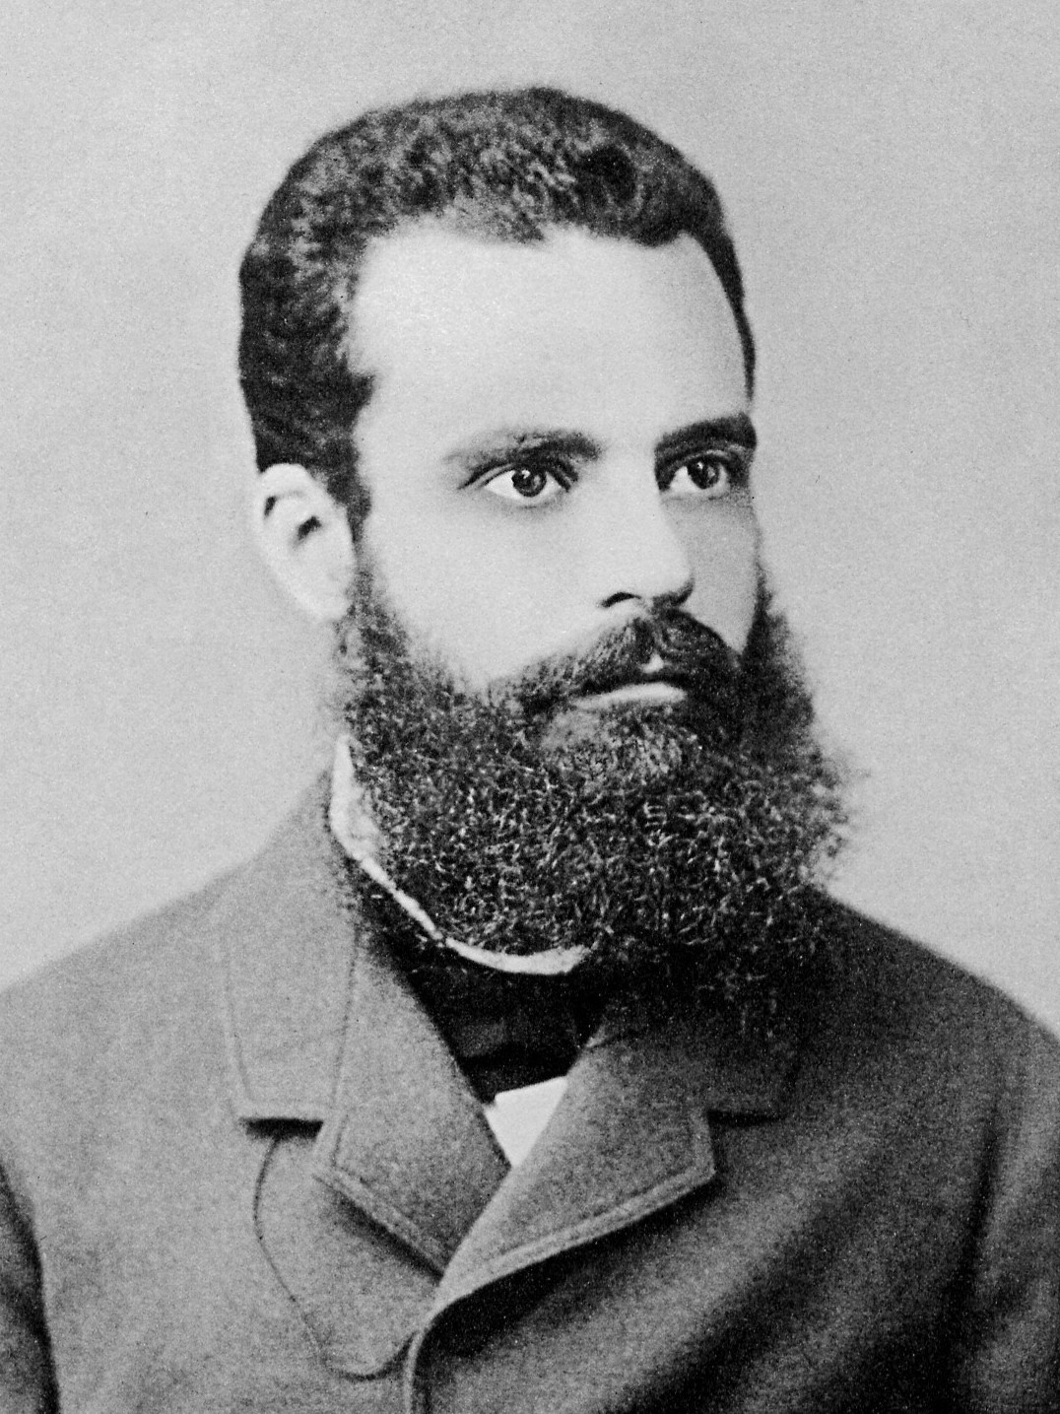
Pareto efficiency/optimality
An allocation is Pareto optimal/efficient if we can’t make some people better off without hurting others
Says nothing about justice or fairness
Vilfredo Pareto 1848-1923

Slide 195
“Efficient” or “Optimal”?
“Efficient” sounds like we only try to produce as much as possible, and that’s not the case
"Optimal” sounds like it’s the “best”, at least as good as anything else – and it only means that there’s nothing better

Slide 196
The First Welfare Theorem
In any event, Pareto optimality/efficiency is a nice property to have
The First Welfare Theorem says that any allocation that is the result of a general equilibrium has this property
But consumer who reach satiation can destroy it
That’s why, as economists, we see something positive in the fact that people don’t reach satiation so easily…

Slide 197
Strict monotonicity
$U$ is strictly increasing in each variable:
If $x>x^{′}$and$y≥y′$
or $x≥x^{′}$and $y>y^{′}$
then
$U\left(x,y\right)>U\left(x^{′},y^{′}\right)$
– necessarily satisfies basic monotonicity as well

Slide 198
Is strict monotonicity plausible?
How much water can you drink?
In many good we will reach satiation
Even if we still want something else (diamonds?)

Slide 199
Weak monotonicity
Basic monotonicity +
If $x{>x}^{′}$and $y>y′$
then
$$U\left(x,y\right)>U(x^{′},y^{′})$$
There may be satiation in some goods, but not in all

Slide 200
Example: weak but not strict monotonicity
$$y$$
$$U\left(x,y\right)=\min\left(x,10\right)+y$$
$$10$$
$$x$$

Slide 201
Weak monotonicity suffices
For the consumer to be on the budget line
…and wish to sell any extras in the market
For the equilibria to be Pareto efficient/optimal
$$y$$
$$x$$

Slide 202
Consumer theory: Convexity

Slide 203
Problems
There are more complex feasible sets
The marginality condition doesn’t always help

Slide 204
More interesting “budget” sets
Suppose you have to decide how many movies and how many theater shows to watch
 | Good | Price | Minutes
$$x$$ | movie | 40 | 120
$$y$$ | theater | 100 | 60
 | Budget | 400 | 600

Slide 205
The budget(s) set
$$y$$
$$40x+100y≤400$$
$$120x+60y≤600$$
$$x,y≥0$$
$$10$$
$$4$$
$$(3.75,2.5)$$
$$5$$
$$10$$
$$x$$

Slide 206
Let’s maximize utility
$$y$$
$$\text{Max} V\left(x,y\right)=x^{0.3}y^{0.7}$$
$$40x+100y≤400$$
$$120x+60y≤600$$
$$x,y≥0$$
$$10$$
$$4$$
$$(3.75,2.5)$$
$$5$$
$$10$$
$$x$$

Slide 207
Looking for a tangency point, say…
$$y$$
$$\text{Max} V\left(x,y\right)=x^{0.3}y^{0.7}$$
$$40x+100y≤400$$
$$120x+60y≤600$$
$$x,y≥0$$
$$10$$
$$4$$
$$(3.75,2.5)$$
$$5$$
$$10$$
$$x$$

Slide 208
Indeed,
$$y$$
$$\text{Max} V\left(x,y\right)=x^{0.3}y^{0.7}$$
$$40x+100y=400$$
$$10$$
$$x=a\frac{1}{p_{x}}I=0.3\frac{1}{40}400=3$$
$y=\left(1−a\right)\frac{1}{p_{y}}I=$ $0.7\frac{1}{100}400=2.8$
$$4$$
$$(3,2.8)$$
$$(3.75,2.5)$$
The tangency with the first line is within the relevant range and we’re happy
$$5$$
$$10$$
$$x$$

Slide 209
But if preferences were different…
$$y$$
$$\text{Max} V\left(x,y\right)=x^{0.8}y^{0.2}$$
$$40x+100y=400$$
$$10$$
$$x=a\frac{1}{p_{x}}I=0.8\frac{1}{40}400=8$$
$y=\left(1−a\right)\frac{1}{p_{y}}I=$ $0.2\frac{1}{100}400=0.8$
$$4$$
$$(3.75,2.5)$$
$$(8,0.8)$$
The tangency point with this line is outside the range and we’re very unhappy
$$5$$
$$10$$
$$x$$

Slide 210
Looking for tangency with the other segment
$$y$$
$$\text{Max} V\left(x,y\right)=x^{0.8}y^{0.2}$$
$$120x+60y=600$$
$$10$$
$$x=a\frac{1}{p_{x}}I=0.8\frac{1}{120}600=4$$
$y=\left(1−a\right)\frac{1}{p_{y}}I=$ $0.2\frac{1}{60}600=2$
$$4$$
$$(3.75,2.5)$$
$$(4,2)$$
And again there’s tangency with one line that’s in the relevant range (for this line) and we’re happy
$$5$$
$$10$$
$$x$$

Slide 211
Will this always work?
$$y$$
$$\text{Max} V\left(x,y\right)=x^{0.5}y^{0.5}$$
$$40x+100y=400$$
$$10$$
$$x=a\frac{1}{p_{x}}I=0.5\frac{1}{40}400=5$$
$y=\left(1−a\right)\frac{1}{p_{y}}I=$ $0.5\frac{1}{100}400=2$
$$4$$
$$(3.75,2.5)$$
$$(5,2)$$
The tangency point with this line is again outside the range and we’re again unhappy
$$5$$
$$10$$
$$x$$

Slide 212
On the other hand…
$$y$$
$$\text{Max} V\left(x,y\right)=x^{0.5}y^{0.5}$$
$$120x+60y=600$$
$$10$$
$$x=a\frac{1}{p_{x}}I=0.5\frac{1}{120}600=2.5$$
$y=\left(1−a\right)\frac{1}{p_{y}}I=$ $0.5\frac{1}{60}600=5$
$$(2.5,5)$$
$$4$$
$$(3.75,2.5)$$
The tangency point with the other line is also outside the relevant range and we’re very unhappy
$$5$$
$$10$$
$$x$$

Slide 213
So what’s going on?
$$y$$
$$\text{Max} V\left(x,y\right)=x^{0.5}y^{0.5}$$
$$40x+100y=400$$
$$120x+60y=600$$
$$10$$
$$x=3.75$$
$$y=2.5$$
$$4$$
$$(3.75,2.5)$$
Well, we can’t call it tangency, but we do have separation
$$5$$
$$10$$
$$x$$

Slide 214
More generally
When there are several linear inequality and they all have to be satisfied (“and”) we look for tangencies
If one of them is in the relevant range we’re happy
If not, we look at the extreme points
(We don’t need to look at all of them – if one of them is “in between” slope we’re done)
(And something like this works in higher dimensions, too)
$$y$$
$$x$$

Slide 215
Encouraged and cheered up,
Let us now assume that
$$p_{x}=p_{y}=1, I=200$$
But there are discounts for large quantities: above 100 the price of $x$ per unit goes down by 50%
${ p}_{x}=\frac{1}{2}$ if $x>100$

Slide 216
Which bundles are feasible
Distinguish between
$$x≤100$$
and
$$x>100$$
$$y$$
$$200$$
$$p_{x}=1$$
$$150$$
$$p_{x}=0.5$$
$$100$$
$$100$$
$$200$$
$$300$$
$$x$$

Slide 217
The budget set
In the range
$$x≤100$$
the price is
and the budget line:
$$y$$
$$p_{x}=1$$
$$200$$
$$150$$
$$x+y≤200$$
And, as usual,
$$x,y≥0$$
$$100$$
$$100$$
$$200$$
$$300$$
$$x$$

Slide 218
The budget set – cont.
In the range
$$x>100$$
the price is
and the constraint is
$$y$$
$$p_{x}=0.5$$
$$200$$
$$150$$
$$0.5\left(x−100\right)+y≤\left(200−100\right)=100$$
(Because we already spent 100 on the first 100 units)
or
$$0.5x+y≤150$$
(and $x,y≥0$ )
$$100$$
$$100$$
$$200$$
$$300$$
$$x$$

Slide 219
The budget set, therefore:
$$y$$
And we see we could also write
$$x+y≤200$$
or
$$0.5x+y≤150$$
and, as usual
$$x,y≥0$$
$$200$$
$$150$$
$$100$$
$$100$$
$$200$$
$$300$$
$$x$$

Slide 220
Let’s maximize
$$y$$
$$\text{Max} V\left(x,y\right)=x^{0.45}y^{0.55}$$
$$x+y≤200$$
or
$$0.5x+y≤150$$
$$(x,y≥0)$$
$$200$$
$$150$$
$$100$$
$$100$$
$$200$$
$$300$$
$$x$$

Slide 221
Looking for tangency
$$y$$
$$\text{Max} V\left(x,y\right)=x^{0.45}y^{0.55}$$
Let’s try tangency with
$$x+y=200$$
$$200$$
$$150$$
$$x=a\frac{1}{p_{x}}I=0.45\frac{1}{1}200=90$$
$y=\left(1−a\right)\frac{1}{p_{y}}I=$ $0.55\frac{1}{1}200=110$
$$(90,110)$$
$$100$$
$$100$$
$$200$$
$$300$$
$$x$$
We made it!

Slide 222
But there’s another tangency point
$$y$$
$$\text{Max} V\left(x,y\right)=x^{0.45}y^{0.55}$$
Tangency with
$$0.5x+y=150$$
$$200$$
$$x=a\frac{1}{p_{x}}I=0.45\frac{1}{0.5}150=135$$
$y=\left(1−a\right)\frac{1}{p_{y}}I=$ $0.55\frac{1}{1}150=82.5$
$$150$$
$$(90,110)$$
$$100$$
$$(135,82.5)$$
… and in this case
$${135}^{0.45}{82.5}^{0.55}=102.96>$$
$${90}^{0.45}{110}^{0.55}=100.50$$
$$100$$
$$200$$
$$300$$
$$x$$

Slide 223
Generally
$$y$$
If there are several linear inequalities and only one should be satisfied (“or”), we will look for all tangency points
We will need to compare them
And the intersection points
(We can save a bit: the intersection between two segments will not be better than both tangency points on them)
$$x$$

Slide 224
An “or” condition between inequalities
$$y$$
May appear when there are discounts
Or when we can buy in one of several markets, but not to mix between them
Or to order from one of several suppliers…
$$x$$

Slide 225
Convex sets
For every two points in the set, the entire interval connecting them is also in the set

Slide 226
Non-convex sets
There exists at least one pair of points in the set, such that some of the interval connecting them is outside the set

Slide 227
The interval connecting two points
$$y$$
For example, the interval connecting
$$\left(1,5\right)$$
and
$$\left(3,1\right)$$
$$\left(1,5\right)$$
$$5$$
$$\left(3,1\right)$$
$$1$$
$$1$$
$$3$$
$$x$$

Slide 228
The interval formula – cont.
$$y$$
Consider, for example, the mid-point
What’s its $x$ value ?
$$\frac{1+3}{2}=2$$
$$\left(1,5\right)$$
$$5$$
$$\left(3,1\right)$$
$$1$$
$$1$$
$$2$$
$$3$$
$$x$$

Slide 229
And, similarly
$$y$$
The midpoint’s $y$ value is
$$\frac{5+1}{2}=3$$
$$\left(1,5\right)$$
$$5$$
$$3$$
$$\left(3,1\right)$$
$$1$$
$$1$$
$$3$$
$$x$$

Slide 230
In short,
$$y$$
The midpoint is $\left(2,3\right)$
In other words, the average values:
$$\frac{1}{2}\left(1,5\right)+\frac{1}{2}\left(3,1\right)=(2,3)$$
$$\left(1,5\right)$$
$$5$$
$$\left(2,3\right)$$
$$3$$
$$\left(3,1\right)$$
$$1$$
$$1$$
$$2$$
$$3$$
$$x$$

Slide 231
And what about other points?
$$y$$
Their coordinates are weighted average of those of the extreme points – while always using the same weights
$$a\left(1,5\right)+\left(1−a\right)\left(3,1\right)$$
=$(a∗1+\left(1−a\right)∗3$, $a∗5+\left(1−a\right)∗1)$
For $a=1$ we get
and for $a=0$ we get
$$\left(1,5\right)$$
$$5$$
$$y$$
$$\left(3,1\right)$$
$$1$$
$$\left(1,5\right)$$
$$1$$
$$x$$
$$3$$
$$x$$
$$\left(3,1\right)$$

Slide 232
Convex budget sets
$$y$$
Obviously, the classic one:
$$p_{x}x+p_{y}y≤I$$
$$x,y≥0$$
$$x$$

Slide 233
As well as…
$$y$$
Anything we can get by intersection (“and”) of linear inequalities
(or, more generally, the intersection of any convex sets)
$$x$$

Slide 234
But not…
$$y$$
The union of convex sets need not be convex
$$x$$

Slide 235
A non-convex budget set
$$y$$
Can be problematic: the marginality condition is no longer sufficient for optimality
$$x$$

Slide 236
Non-convex preferences
$$y$$
$$U\left(x,y\right)=x^{2}+y^{2}$$
Increasing marginal utility (in each variable):
$$U_{x}=2x$$
$$U_{y}=2y$$
$$x$$

Slide 237
The marginality condition without convexity
$$y$$
$$U\left(x,y\right)=x^{2}+y^{2}$$
The tangency point might be the worst point on the line
$$x$$

Slide 238
Examples of increasing marginal utility
$$U\left(x,y\right)=x^{2}+y^{2}$$
$x,y$ –minutes of watching a movie
$x,y$– amount of heroin and cocaine
$x,y$– practice time of two athletes for the Olympic games

Slide 239
Convex preferences
$$y$$
The “better than” sets
$$U\left(x,y\right)≥c$$
are convex,
(for every $c$)
$$x$$

Slide 240
How can we tell if preferences are convex?
$$y$$
Drawing “better than” sets
Comparing the slope (marginal rate of substitution) of the curve along it
And another useful rule:
$$x$$

Slide 241
A sufficient condition for convex preferences
If it so happens that
$$U\left(x,y\right)=U_{1}\left(x\right)+U_{2}\left(y\right)$$
where each of $U_{1}$ and $U_{2}$ is concave (in its own variable)
$$U\left(x,y\right)=a∗x+b∗y$$
$$U\left(x,y\right)=a∗log\left(x\right)+b∗log(y)$$
$$U\left(x,y\right)=a∗x+b∗log(y)$$
… then the preferences are convex

Slide 242
How come that concave $U_{1}$ $U_{2}$ imply convex preferences?
$$y$$
Assume they are concave
Decreasing marginal utility of each product
And we get a less steep indifference curve as we slide downwards (and to the right)
$$x$$

Slide 243
The importance of convexity
As we just argued, it simplifies our lives as economists who try to predict choices
But it also makes the optimization story more likely
How does the household “behave as if” it were maximizing a utility function?
Under convexity: small improvements would lead to an optimal solution

Slide 244
Consumer theory: Comparative statics / Sensitivity analysis

Slide 245
Consumer theory: Changes in income

Slide 246
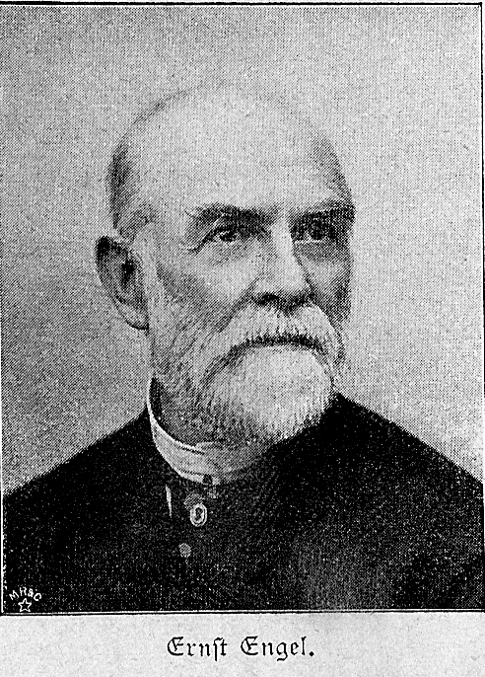
Changing income $I$
ICC—Income-Consumption Curve
Its habitat is the consumption bundles space
Income isn’t represented graphically
Engel Curve
Lives in the Income-Good (quantity) space
The quantities of the other goods are not represented graphically
Ernst Engel 1821-1896

Slide 247
The ICC for CD preferences
$$x=a\frac{1}{p_{x}}I$$
$$y=(1−a)\frac{1}{p_{y}}I$$
Recall that these preferences are homothetic:
The slope $\frac{U_{x}}{U_{y}}$ is constant along any ray that emanates from the origin $\left(0,0\right)$
$$y$$
ICC
$$x$$

Slide 248
The Engel Curve
Consider the optimal solution
$$x=a\frac{1}{p_{x}}I$$
$$y=(1−a)\frac{1}{p_{y}}I$$
$$x$$
Focus on the demand for one good and observe how it changes as a function of income
$$I$$

Slide 249
The Engel curve and income elasticity
$$x=a\frac{1}{p_{x}}I$$
$$y=(1−a)\frac{1}{p_{y}}I$$
For CD preferences, income elasticity is 1
$η_{xI}$= $\frac{\frac{∂x}{∂I}}{\frac{x}{I}}$ = $\frac{\frac{a}{p_{x}}}{\frac{a}{p_{x}}}=1$
$$x$$
$η_{xI}$ $≡1$ if and only if the demand for $x$ is a linear function of income, that is $x=cI$ for some $c$
$$I$$

Slide 250
The general concept of elasticity
Given a function $z=z(w)$ we wonder how sensitive $z$ is relative to changes in $w$
We have the (partial) derivative
$$\frac{∂z}{∂w}$$
But we want a “pure” measure, independent of measurement units:
$$η_{z,w}=\frac{\frac{∂z}{∂w}}{\frac{z}{w}}$$

Slide 251
Elasticity
$$η_{z,w}=\frac{\frac{∂z}{∂w}}{\frac{z}{w}}=\frac{\frac{∂z}{z}}{\frac{∂w}{w}}$$
Constant elasticity:
$${z=aw^{c},(a>0)⟺ η}_{z,w}=c$$
For instance:
$${z=aw⟺ η}_{z,w}=+1$$
$${z=\frac{a}{w}⟺ η}_{z,w}=−1$$

Slide 252
Constant Elasticity
If
$$z=aw^{c}$$
Then
$$η_{z,w}=\frac{\frac{∂z}{∂w}}{\frac{z}{w}}=\frac{acw^{c−1}}{aw^{c}/w}=\frac{acw^{c−1}}{aw^{c−1}}=c$$

Slide 253
Constant Elasticity – cont.
And if $η_{z,w}=\frac{\frac{∂z}{∂w}}{\frac{z}{w}}=\frac{\frac{∂z}{z}}{\frac{∂w}{w}}=c$
Then
$\frac{∂z}{z}=$c$∙ \frac{∂w}{w}$
$$d\left(\log\left(z\right)\right)=c∙d\left(\log\left(w\right)\right)$$
$\log\left(z\right)=c∙$ $\log\left(w\right)+b=log\left(w^{c}\right)+\log{(e^{b})}=log\left({aw}^{c}\right)$
for $a=e^{b}$
and
$$z=aw^{c}$$

Slide 254
Responses to income changes
${ η}_{x,I}>0$ – $x$ increases, a “normal” good
${ η}_{x,I}=0$ – $x$ doesn’t change, a “neutral good”
${ η}_{x,I}<0$ – $x$ decreases, an “inferior” good in a certain range
… why “in a certain range” ?

Slide 255
Further distinction among normal goods:
${ η}_{x,I}>1$ – a luxury good
${ η}_{x,I}=1$ – a proportional good
${0<η}_{x,I}<1$ –a basic/essential good

Slide 256
For CD preferences
We got
${ η}_{x,I}={ η}_{y,I}=1$
And this makes sense: if there are only two goods, and one has income elasticity of $1$, so should the other one:
$$p_{x}x+p_{y}y=I$$
Suppose we increase income by 1%
$$p_{x}(1.01)x+p_{y}(1+?)y=(1.01)I$$

Slide 257
More generally
Some weighted average of income elasticities (across all goods) is equal to $1$
$${ α η}_{x,I}+{ \left(1−α\right) η}_{y,I}=1$$
Hence it is impossible that all goods be luxury goods
Or that all be basic goods

Slide 258
The ICC for linear preferences
$$U\left(x,y\right)=ax+by$$
Surely homothetic:
The slope $\frac{U_{x}}{U_{y}}=\frac{a}{b}$ is constant not only along each ray (emanating from the origin), but also across rays
$$y$$
$$x$$

Slide 259
ICC for linear preferences – cont.
If we have
$$\frac{p_{x}}{p_{y}}>\frac{a}{b}$$
$$y$$
That is
ICC
$$\frac{b}{p_{y}}>\frac{a}{p_{x}}$$
The solution is
$$x =0$$
$$y=\frac{1}{p_{y}}I$$
$$x$$

Slide 260
Engel Curve for linear preferences
$$U\left(x,y\right)=ax+by$$
Say, $\frac{p_{x}}{p_{y}}>\frac{a}{b}$
$$x=0$$
$$y=\frac{1}{p_{y}}I$$
The optimal solution is
$$y$$
$$x$$
$$I$$
$$I$$

Slide 261
The ICC for linear preferences…
And if
$$\frac{p_{x}}{p_{y}}<\frac{a}{b}$$
$$y$$
That is
$$\frac{b}{p_{y}}<\frac{a}{p_{x}}$$
The solution is
$$x =\frac{1}{p_{x}}I$$
$y=$ $0$
ICC
$$x$$

Slide 262
Engel Curve for linear preferences
$$U\left(x,y\right)=ax+by$$
Say, $\frac{p_{x}}{p_{y}}<\frac{a}{b}$
$$x =\frac{1}{p_{x}}I$$
$y=$ $0$
The optimal solution is
$$y$$
$$x$$
$$I$$
$$I$$

Slide 263
The ICC yet again
Wait, but what if
$$\frac{p_{x}}{p_{y}}=\frac{a}{b}$$
$$y$$
That is,
$$\frac{b}{p_{y}}=\frac{a}{p_{x}}$$
ICC?
Any point on the budget line is a solution and the ICC becomes the entire orthant
$$x$$

Slide 264
Consumer theory: Changes in price

Slide 265
Changing price $p_{x}$
PCC (Price Consumption Curve)
Resides in the bundles space
Price isn’t represented graphically
Demand curve
Resides in the price-quantity space (for a given good)
The other quantities are not represented graphically
Demand and cross demand curve

Slide 266
The PCC for CD preferences
$$x=a\frac{1}{p_{x}}I$$
$$y=(1−a)\frac{1}{p_{y}}I$$
$$y$$
$$\frac{I}{p_{y}}$$
PCC$(1)$
$$x$$

Slide 267
Demand curve
$$x$$
$$x=a\frac{1}{p_{x}}I$$
$η_{xp_{x}}$= $\frac{\frac{∂x}{∂p_{x}}}{\frac{x}{p_{x}}}$ = $\frac{− \frac{aI}{p_{x}2}}{\frac{aI}{p_{x}2}}=−1$
($η_{xp_{x}}$ $≡−1$ hyperbola )
$$p_{x}$$

Slide 268
Cross demand curve
$$y$$
$$y=(1−a)\frac{1}{p_{y}}I$$
$η_{xp_{y}}$= $\frac{\frac{∂x}{∂p_{y}}}{\frac{x}{p_{y}}}=0$
$$(1−a)\frac{1}{p_{y}}I$$
$(η_{xp_{y}}$ $≡$ 0 constant)
$$p_{x}$$

Slide 269
The slope of the demand curve
$$x$$
We’d expect
$η_{xp_{x}}<$ $0$
And this is indeed typical. Almost always true. Why almost?
$$p_{x}$$

Slide 270
What happens when a price changes?
Suppose $p_{x}↑$
${p′}_{x}>p_{x}$
$$\frac{I}{p_{y}}$$
The budget line is “tighter”
Its slope changes, too
$$\frac{I}{{p′}_{x}}$$
$$\frac{I}{p_{x}}$$

Slide 271
Income and substitution effects
$${p′}_{x}>p_{x}$$
Indeed
$$x_{B}<x_{A}$$
Why?
The consumer is “poorer”
The price ratio has changed
$$\frac{I}{p_{y}}$$
A
B
$$x_{B}$$
$$x_{A}$$
$$\frac{I}{{p′}_{x}}$$
$$\frac{I}{p_{x}}$$

Slide 272
Trying to tell these apart
Budget line C goes through the old point, but with the new slope
$${(x}_{B}−x_{A}) = \left(x_{B}−x_{C}\right) +(x_{C}−x_{A})$$
Overall change = income effect + substitution effect
$$\frac{I}{p_{y}}$$
C
A
B
$$x_{B}$$
$$x_{A}$$
$$\frac{I}{p_{x}}$$
$$\frac{I}{{p′}_{x}}$$

Slide 273
For example
$$y$$
$U\left(x,y\right)=\log\left(x\right)+\log\left(y\right)$
$I=120, { p}_{x}=2, p_{y}=2$
$x=\frac{1}{2} \frac{1}{p_{x}}I=\frac{1}{2}∙\frac{1}{2}∙120=30$
$y=\frac{1}{2} \frac{1}{p_{y}}I=\frac{1}{2}∙\frac{1}{2}∙120=30$
$$60$$
A
$$y_{A}=30$$
$$x_{A}=30$$
$$60$$
$$x$$

Slide 274
Suppose the price has gone up
$$y$$
$p_{x′}=3>2=p_{x}$
From budget line A
$$A\left(2,2,120\right)→\left(30,30\right)$$
We switch to line B
$$B\left(3,2,120\right)→\left(20,30\right)$$
$$60$$
B
A
$$y_{A}=30$$
$$x_{B}=20$$
$$x_{A}=30$$
$$60$$
$$x$$

Slide 275
Introduce the third budget line
$$C\left(3,2,?\right)$$
The price are the new ones $\left(3,2\right)$
Which level of income would go through $A\left(30,30\right)$ ?
$$I=3∙30+2∙30=90+60=150$$

Slide 276
Hence we compare between…
$A\left(2,2,120\right)→\left(30,30\right)$
$B\left(3,2,120\right)→\left(20,30\right)$
$C\left(3,2,150\right)→\left(25,37.5\right)$
$$\left(20−30\right) = \left(20−25\right) + (25−30)$$
Overall change = income effect + substitution effect
$$60$$
C
A
B
$$x_{B}=20$$
$$x_{A}=30$$
$$60$$
$$x_{C}=25$$

Slide 277
The substitution effect cannot be positive
$$x$$
If the price of a good goes up, the substitution effect will not make us want more of it
C
A
$$p_{x}$$

Slide 278
The substitution effect can be zero
$$x$$
Say
$$U\left(x,y\right)=min⁡(x,y)$$
$$U\left(x,y\right)=c$$
A,C
$$p_{x}$$

Slide 279
Income effect
Price increase real income has gone down
The income effect is
negative for a normal good
zero for a neutral good
positive for an inferior good
For a normal good the income and substitution effects are in the same direction

Slide 280
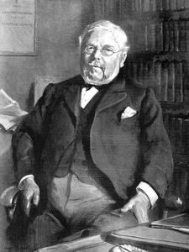
Giffen goods
For inferior goods, the income and substitution effects are in opposite directions
Typically, the substitution effect is stronger (that’s an empirical fact)
If this isn’t the case, the good is referred to as a Giffen good.
$$η_{{xp}_{x}}>0$$
Robert Giffen 1837-1910

Slide 281
Let us not confuse Giffen goods with
Uncertainty about quality (a $10 Rolex)
conspicuous consumption

Slide 282
Compensations: Slutsky and Hicks
Back to the example
$$U\left(x,y\right)=\log\left(x\right)+\log\left(y\right)$$
$$I=120$$
$$p_{x}=2,{p′}_{x}=3, p_{y}=2$$
Suppose that the consumer is compensated so that she can consume bundle A
$$60$$
$$60$$
C
$$37.5$$
A
$$30$$
B
$$x_{B}=20$$
$$x_{A}=30$$
$$60$$
$$x_{C}=25$$

Slide 283
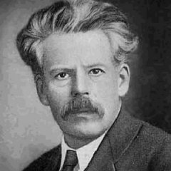
What’s the impact on utility?
$$\left(p_{x},p_{y},I\right)→\left(x,y\right)→V\left(x,y\right)$$
$$V\left(x,y\right)=xy$$
$$[U\left(x,y\right)=\log\left(x\right)+\log\left(y\right)]$$
$A\left(2,2,120\right)→ \left(30,30\right) → 900$
$$B\left(3,2,120\right)→ \left(20,30\right) → 600$$
$$C\left(3,2,150\right)→ \left(25,37.5\right) → 937.5$$
150 – the compensated income, according to Slutsky
Slutsky compensation: 150-120=30
Evgeny Evgenievich Slutsky 1880-1948

Slide 284
Neither shocked nor upset
$$y$$
It’s natural that rotating the budget line around a point (A) would change the optimal bundle
And that’s perfectly fine with us…
60
C
A
60
$$x$$

Slide 285
However
$$y$$
Maybe the compensation shouldn’t be that high?
Maybe it’s enough to go back to the old utility level, rather than the old physical quantities (which are no longer optimal)?
60
D
A
30
30
60
$$x$$

Slide 286
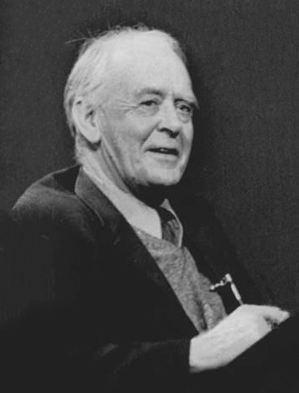
The compensation according to Hicks
Consider the table again
$\left(p_{x},p_{y},I\right) → \left(x,y\right) →V\left(x,y\right)$
$A \left(2,2,120\right)→ \left(30,30\right) →900$
$B \left(3,2,120\right)→ \left(20,30\right) →600$
$C \left(3,2,150\right)→ \left(25,37.5\right) →937.5$
$D \left(3,2,?\right) → \left(x,y\right) →900$
John Hicks 1904-1989

Slide 287
Hicks compensation – cont.
For $\left(3,2,I\right)$ we have
$$x=\frac{1}{2}∙\frac{1}{3}∙I=\frac{1}{6}I$$
$$y=\frac{1}{2}∙\frac{1}{2}∙I=\frac{1}{4}I$$
To get $V\left(x,y\right)=xy=900$ we will require
$$\frac{1}{4}I∙\frac{1}{6}I=900$$
$$I^{2}=900∙24=21,600$$
$$I=146.96$$

Slide 288
The compensations of Slutsky and Hicks
Slutzky: changes income to be able to be consume the original bundle
Hicks: changes income to be able to be consume at the original utility level
Hicks' sounds more fair, but requires knowledge (/estimation) of the utility function

Slide 289
The PCC for linear preferences
$$U\left(x,y\right)=ax+by$$
$$y$$
If $\frac{p_{x}}{p_{y}}<\frac{a}{b}$ the solution is $\left(\frac{I}{p_{x}},0\right)$
$$\frac{I}{p_{y}}$$
If $\frac{p_{x}}{p_{y}}>\frac{a}{b}$ the solution is $\left(0,\frac{I}{p_{y}}\right)$
PCC$(1)$
If $\frac{p_{x}}{p_{y}}=\frac{a}{b}$ it's any point in between
$$x$$

Slide 290
The demand "function"
$$x$$
For $p_{x}<\frac{a}{b}p_{y}$ it's $x=\frac{I}{p_{x}}$
For $p_{x}>\frac{a}{b}p_{y}$ it's $x=0$
(And for ${ p}_{x}=\frac{a}{b}p_{y}$ any value $0≤x≤\frac{I}{p_{x}}$ )
The elasticity is
$η_{xp_{x}}$ $≡−1$
in the range $p_{x}<\frac{a}{b}p_{y}$ and not well defined outside it
$$p_{x}$$
$$\frac{a}{b}p_{y}$$

Slide 291
The cross demand "function"
$$y$$
For $p_{x}<\frac{a}{b}p_{y}$ it's $y=0$
For $p_{x}>\frac{a}{b}p_{y}$ it's $y=\frac{I}{p_{y}}$
(And for ${ p}_{x}=\frac{a}{b}p_{y}$ any value $0≤y≤\frac{I}{p_{y}}$ )
$$\frac{I}{p_{y} }$$
The elasticity is
$η_{yp_{x}}$ $≡0$
in the range $p_{x}>\frac{a}{b}p_{y}$ and not well defined outside it
$$p_{x}$$
$$\frac{a}{b}p_{y}$$

Slide 292
An example of a Giffen good
$$U\left(x,y\right)=\min\left(x+y, 100+0.5x\right)$$
Both goods can satisfy hunger, but only good 1 has nutritional value
$x$ – amount of nuts
$y$ – amount of Styrofoam
$x+y$ – total amount that fills the stomach
$0.5x$ – amount of nutritional food
$100+0.5x$– the addition of $100$ guarantees that the consumer starts seeking nutrition only after the hunger is somewhat satisfied

Slide 293
Describing the preferences
$$y$$
$$U\left(x,y\right)=\min\left(x+y, 100+0.5x\right)$$
Which need is the dominant one? Hunger or nutrition? This depends on
$x+y⋛100+0.5x$
or
$$y⋛100−0.5x$$
$$U\left(x,y\right)=100+0.5x$$
100
$$U\left(x,y\right)=x+y$$
200
$$x$$

Slide 294
Indifference curves
$$y$$
$$U\left(x,y\right)=\min\left(x+y, 100+0.5x\right)$$
We distinguish between the two regions:
$$x+y⋛100+0.5x$$
$$y⋛100−0.5x$$
$$U\left(x,y\right)=100+0.5x$$
100
$$U\left(x,y\right)=x+y$$
200
$$x$$

Slide 295
Let’s get the budget line into the picture
$$y$$
$$U\left(x,y\right)=\min\left(x+y, 100+0.5x\right)$$
$$p_{x}x+p_{y}y=I$$
And if
$$p_{x}<p_{y}$$
The consumer will only buy the first good
$$U\left(x,y\right)=100+0.5x$$
100
$$U\left(x,y\right)=x+y$$
200
$$x$$

Slide 296
And this will be true for any income
$$y$$
As long as
$$p_{x}<p_{y}$$
Only the first good is consumed
$$U\left(x,y\right)=100+0.5x$$
100
$$U\left(x,y\right)=x+y$$
200
$$x$$

Slide 297
The interesting case
$$y$$
If
$$p_{x}>p_{y}$$
– for low income the optimal bundle is on the$y$ axis
– for high income the optimal bundle is on the$x$ axis
– and in between on the dotted line
$$U\left(x,y\right)=100+0.5x$$
100
$$U\left(x,y\right)=x+y$$
200
$$x$$

Slide 298
The ICC
$$y$$
If
$$p_{x}>p_{y}$$
– The ICC will first climb up the $y$ axis
– then it will slide down the dotted line
– and finally – flatten onto the $x$ axis
– along the dotted line the second good is inferior
100
200
$$x$$

Slide 299
Next consider a change in price
$$y$$
Let’s start with
$$p_{x}>p_{y}, I<200p_{x}$$
and increase $p_{y}$
At low prices the optimal solution will be on the dotted line
When $p_{y}$ is high enough, the optimal solution will be on the $y$ axis
And when $p_{x}$ is higher (above $p_{x}$) – on the$x$ axis
100
200
$$x$$
$$I/p_{x}$$

Slide 300
A possible PCC
$$y$$
Importantly, there is a range in which it goes down
In this range, an increase in the price of good 2 ($p_{y}$) results in an increase in the demanded quantity $y$
100
200
$$x$$

